Slide 1

Outstanding National Resource Waters
(Tier 3 Waters)
Earl Crapps, Section Manager
Alaska Department of Environmental Conservation
Division of Water, Domestic & Industrial Utilities
Alaska Forum on the Environment
Anchorage, Alaska ● February 7, 2017

Slide 2
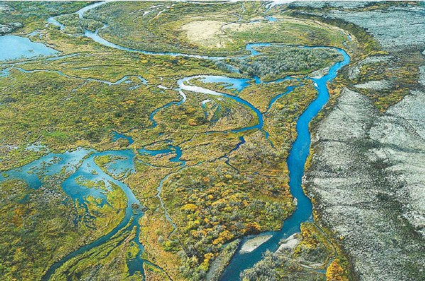
Introduction
  The purpose of this presentation is to provide a background on Outstanding National Resource Waters (ONRWs) or Tier 3 Waters

Slide 3
Water Quality Standards
and Antidegradation
  The Clean Water Act and Federal Regulations (40 CFR §131.12) require states to have an antidegradation policy and implementation methods that:
  Protects existing uses
  Authorize the lowering of water quality (“degradation”) in high quality waters where necessary for social or economic importance
  Offer a mechanism to provide additional protection for water of exceptional ecological or recreational significance (ONRWs or Tier 3)

Slide 4
What are Tiers 1, 2, and 3 in Alaska’s Water Quality Standards
Per the Clean Water Act, Federal regulations, and Alaska’s Water Quality Standards regulations antidegradation policy (18 AAC 70.015)
three classifications, or “tiers,” of waters are identified:
Tier 1 — waters for which not all water quality criteria are met. This can be due to naturally occurring constituents in the water, or can be due to human sources or activities.
Tier 2 — high quality waters, which include the vast majority of waters in Alaska. In these waters, water quality criteria are exceeded, i.e. the water quality is better than criteria.
Tier 3 — waters that are required to be preserved in their current status.

Slide 5
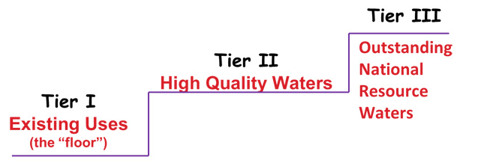

Slide 6
Outstanding National Resource or Tier 3 Water
40 CFR 131.12(a)(3): “Where high quality waters constitute an outstanding National resource, such as waters of the National and State parks and wildlife refuges and waters of exceptional recreational or ecological significance, that water quality shall be maintained and protected.”

Slide 7
How are Tier 3 waters protected?
          Water quality must be “maintained and protected”
            no additional degradation allowed
          Applicable water quality standards are baseline water quality levels at the time of designation
          Discharges to Tier 3 water and tributaries
            temporary, short term, and limited
            Existing discharges at time of designation
Notes:
There are significant long-term consequences of a Tier 3 designation – it stops development in its tracks.
For example: If a Tier 3 is designa
A community or lodge discharging domestic wastewater to a Tier 3 water may have a discharge at the time of designation, but they could not expand.
New lodges or other facilities would not be allowed to discharge – they would have to truck out or use non-discharge systems for their wastewater.

Slide 8
What are examples of Tier 3 waters in other states?
          Waters that are part of national or state parks, wildlife refuge or wilderness areas, special trout waters, federal Wild and Scenic Rivers or other unique waters
            California: Lake Tahoe and Mono Lake
            Montana: all waters in national parks
            Arizona: designated 22 waters
            Washington, Oregon, Idaho, and Nevada: no designations
Notes:
There are significant long-term consequences of a Tier 3 designation – it stops development in its tracks.
For example: If a Tier 3 is designa
A community or lodge discharging domestic wastewater to a Tier 3 water may have a discharge at the time of designation, but they could not expand.
New lodges or other facilities would not be allowed to discharge – they would have to truck out or use non-discharge systems for their wastewater.

Slide 9
What waters have been nominated in Alaska?
Chandalar River — Venetie
Yakutat Forelands — Yakutat
Koktuli River — Dillingham
Chilkat River — Haines
Notes:
Koktuli River

Slide 10
Where we’ve been…
1997 — Antidegradation policy adopted under
18 AAC 70 Water Quality Standards regulations
2010 — Interim implementation methods adopted
2012 — Antidegradation Workgroup
2013 — Final Workgroup Report
2014 — Draft Regulations
2015 — Public Workshop
2016 — Legislation introduced, held
2017 — Public Workshops

Slide 11
Developing a Tier 3 Process
for Alaska
Alaska is currently developing the process for the nomination and designation of Tier 3 waters.
During the 2016 legislative session, the Governor introduced legislation (SB163 and HB283) to establish this Tier 3 nomination and designation process.
  Bills were withdrawn to have more dialog with stakeholders and tribes.
The process needs to work well for all Alaskans and for all waters of the state, now and in the future.

Slide 12
Questions on possible nomination and designation processes
Which waters can be Tier 3 waters? What criteria should be applied before a water can be eligible for Tier 3 designation?
Who can nominate a water for Tier 3 designation, and what requirements should exist for the nomination process?
Once the nomination is received, who should evaluate the nomination to determine the eligibility criteria are met, that the water is a valid candidate for Tier 3 designation?
How will this evaluation process be paid for?
What kind of public process should exist so that Alaskans can weigh in on a Tier 3 decision?
Once a nomination is determined to be a valid candidate for Tier 3 designation, who should make the final decision that the water should indeed be a Tier 3 water?

Slide 13
Possible Tier 3 Criteria and
Nomination Information
To be eligible for Tier 3 designation, the water must have exceptional characteristics relative to other State of Alaska water, including one or more of the following:
  the water is in a relatively pristine condition, largely absent of human sources of degradation, and of exceptional value to the state in this condition;
  the water is of exceptional ecological, economic, or recreational significance; or
  the water is an exceptional and rare example or its type regardless of whether the water is considered high quality

Slide 14
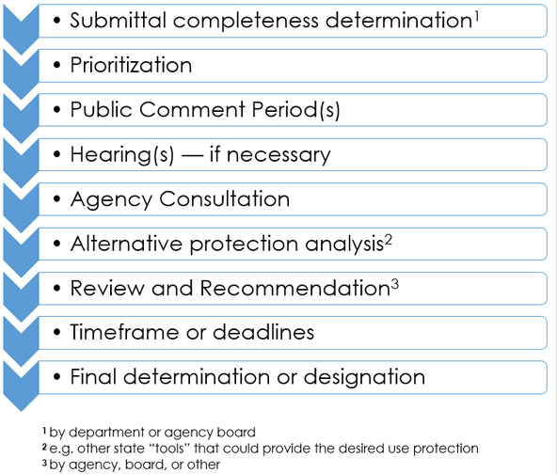
Possible Tier 3 Vetting Process

Slide 15
Options for Designation Authority
Option 1: Legislative decision
Option 2: Tier 3 Board
Option 3: DEC or the Governor
Option 4: Some hybrid or alternative

Slide 16
Tier 3 Public Workshops
We’d like to invite you to participate in one of a series of public workshops to discuss the nomination process and designation options. Workshops will be hosted in the following locations:
Juneau — Monday, March 20, 1-4pm
Anchorage — Tuesday, March 21, 1-4pm
Fairbanks — Wednesday, March 22, 9am-noon
Statewide Teleconference — Thursday, March 23, 4-7pm

Slide 17
Tell us what you think!
Attend a workshop
Register through the website
Submit comments through the website:
http://dec.alaska.gov/water/wqsar/Antidegradation/Tiers123.html

Slide 18
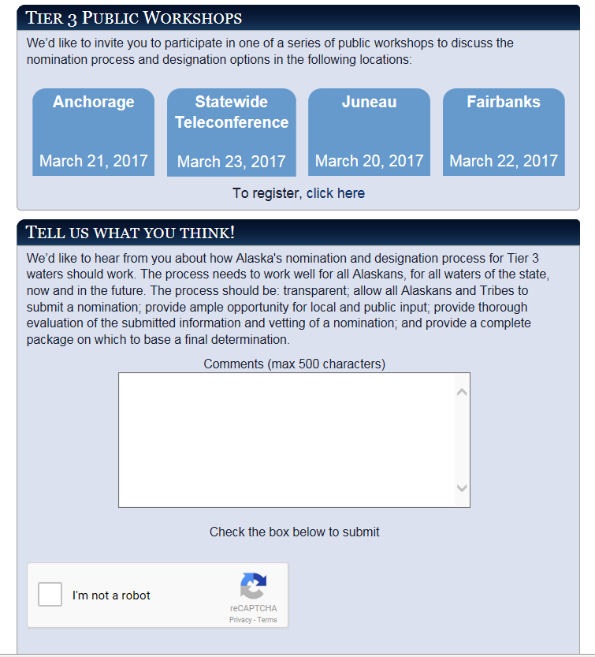

Slide 19
Questions?
Thank you for your time!
Earl Crapps
Division of Water
earl.crapps@alaska.gov
(907) 269-7681

