Slide 1












Alaska Shield 2014
Hazmat Symposium
and Field Exercise
April 1-3, 2014
Kodiak, Alaska

Slide 2
Hazmat Symposium
Sponsors:
  Statewide Hazmat Response Team
  DEC
  DHS&EM
  Alaska West Express
  Host:
  Kodiak Hazmat Team & Fire Dept.
ATTENDEES:
Kodiak Hazmat Team
Anchorage Hazmat Team
Fairbanks Hazmat Team
Juneau Hazmat Team
Ketchikan Hazmat Team
103rd Civil Support Team (CST)
EPA Hazmat Team
Sitka Hazmat Team
Mat-Su Hazmat Team
85th CST – Utah
Kodiak Coast Guard
Kodiak Fire Dept
DEC
DHS&EM
5 Seafood Processors

Slide 3
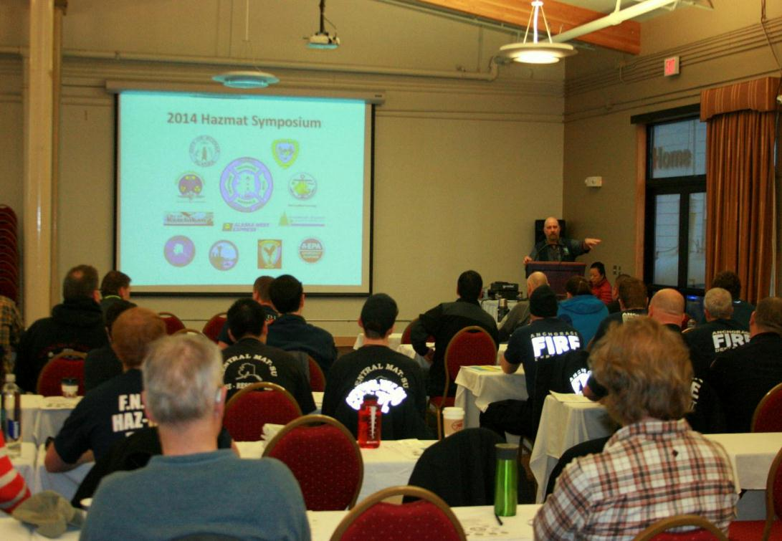
Hazmat Symposium
One full day of classroom topics:
Hazmat Team Activation Process
Hazmat Size-Up
Pre-Entry Hazmat Sampling Refresher
Intermodal Tanks
Hazmat Fire
One full day of Ammonia Awareness/Response

Slide 4
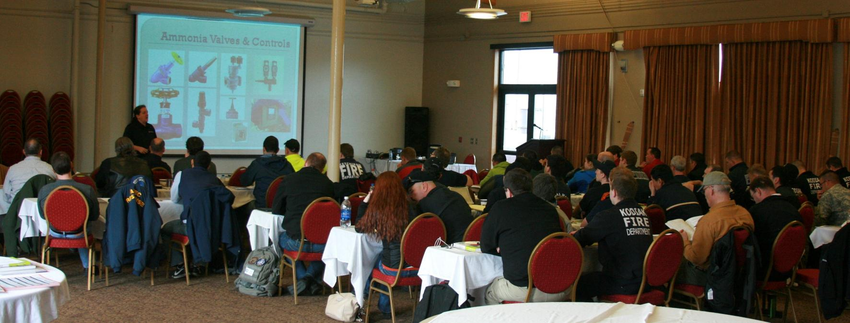
Hazmat Symposium
1st Day Attendance = 70 people
2nd Day Attendance = 75 people

Slide 5
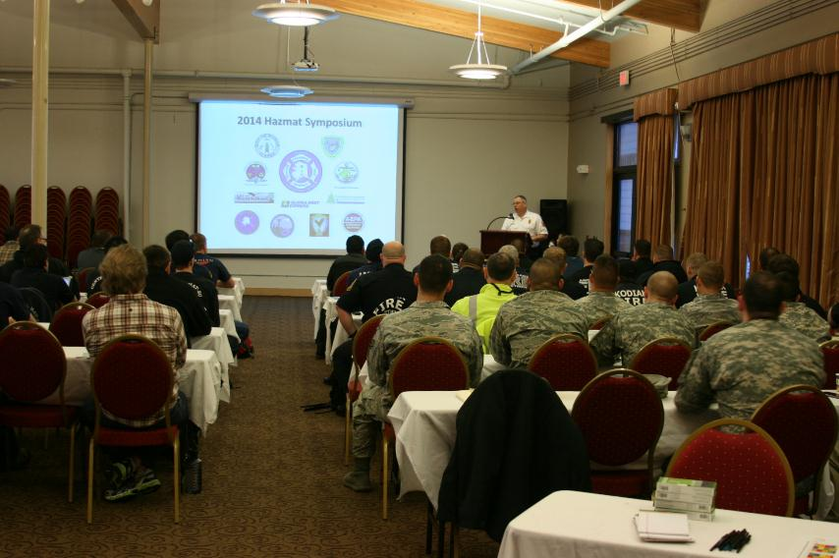
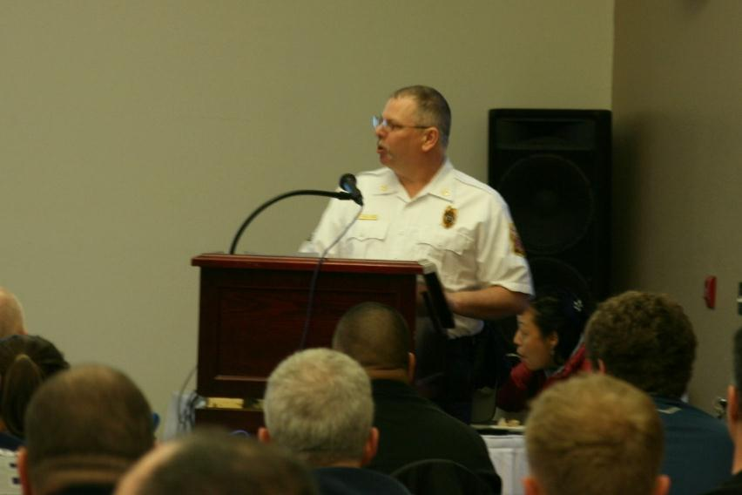
Hazmat Symposium
Deputy Fire Chief Jim Mullican Providing Opening Remarks

Slide 6
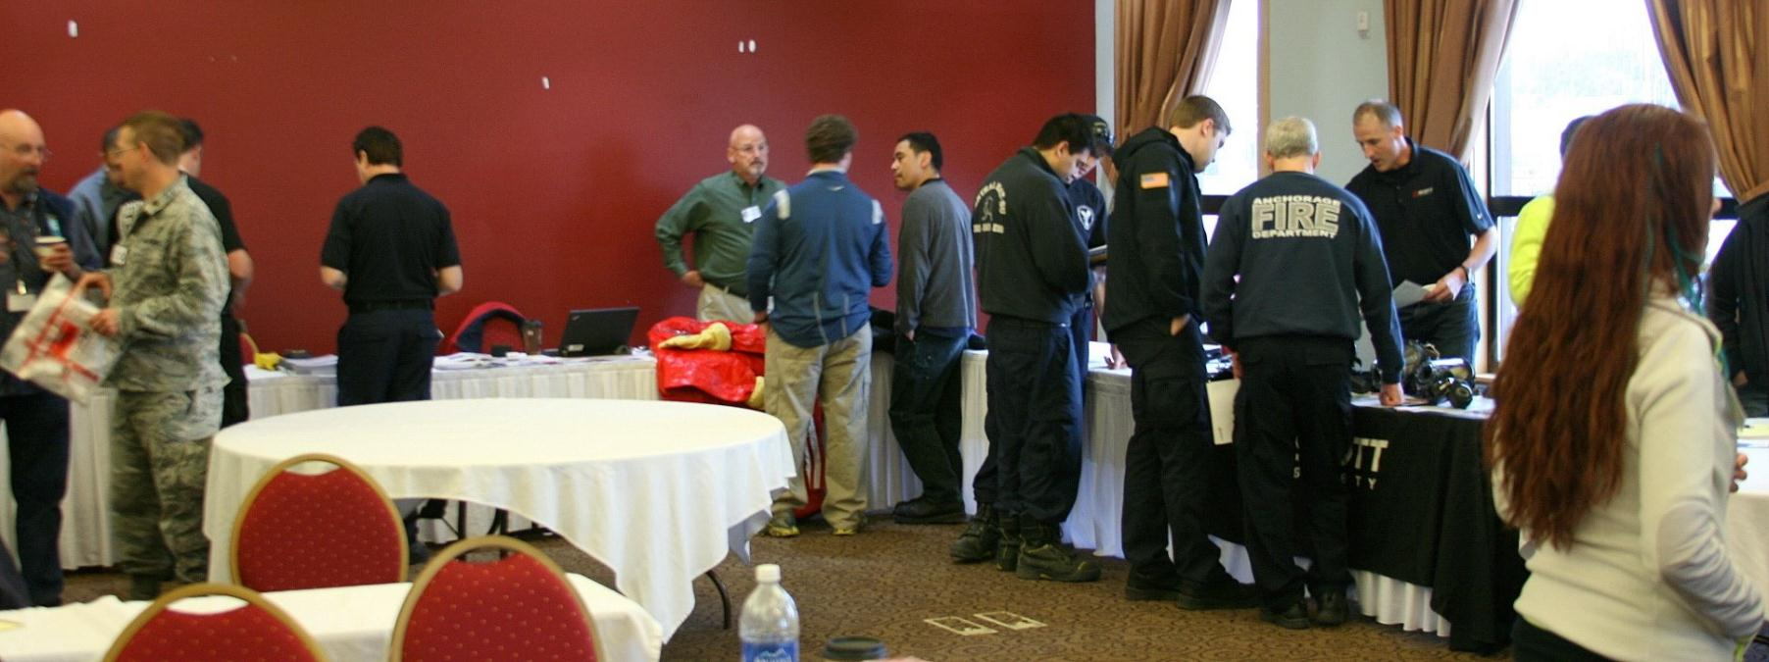
Hazmat Symposium
Three Hazmat Equipment Vendors Displaying Their Goods
Scott Safety, Saint-Gobain, TTT

Slide 7
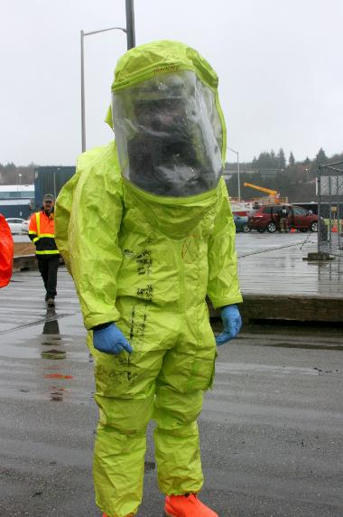
Hazmat Field Exercise
30 Hazmat Technicians From 9 Different Hazmat Teams.
24 Additional Support Staff – Controllers/Facilitators.
Techs Integrated Into 9 Entry Teams.
3 Separate Hazmat Release Scenarios.
1 Wet Decontamination Unit.
EPA HAZCAT Demo.
Rained All Day.

Slide 9
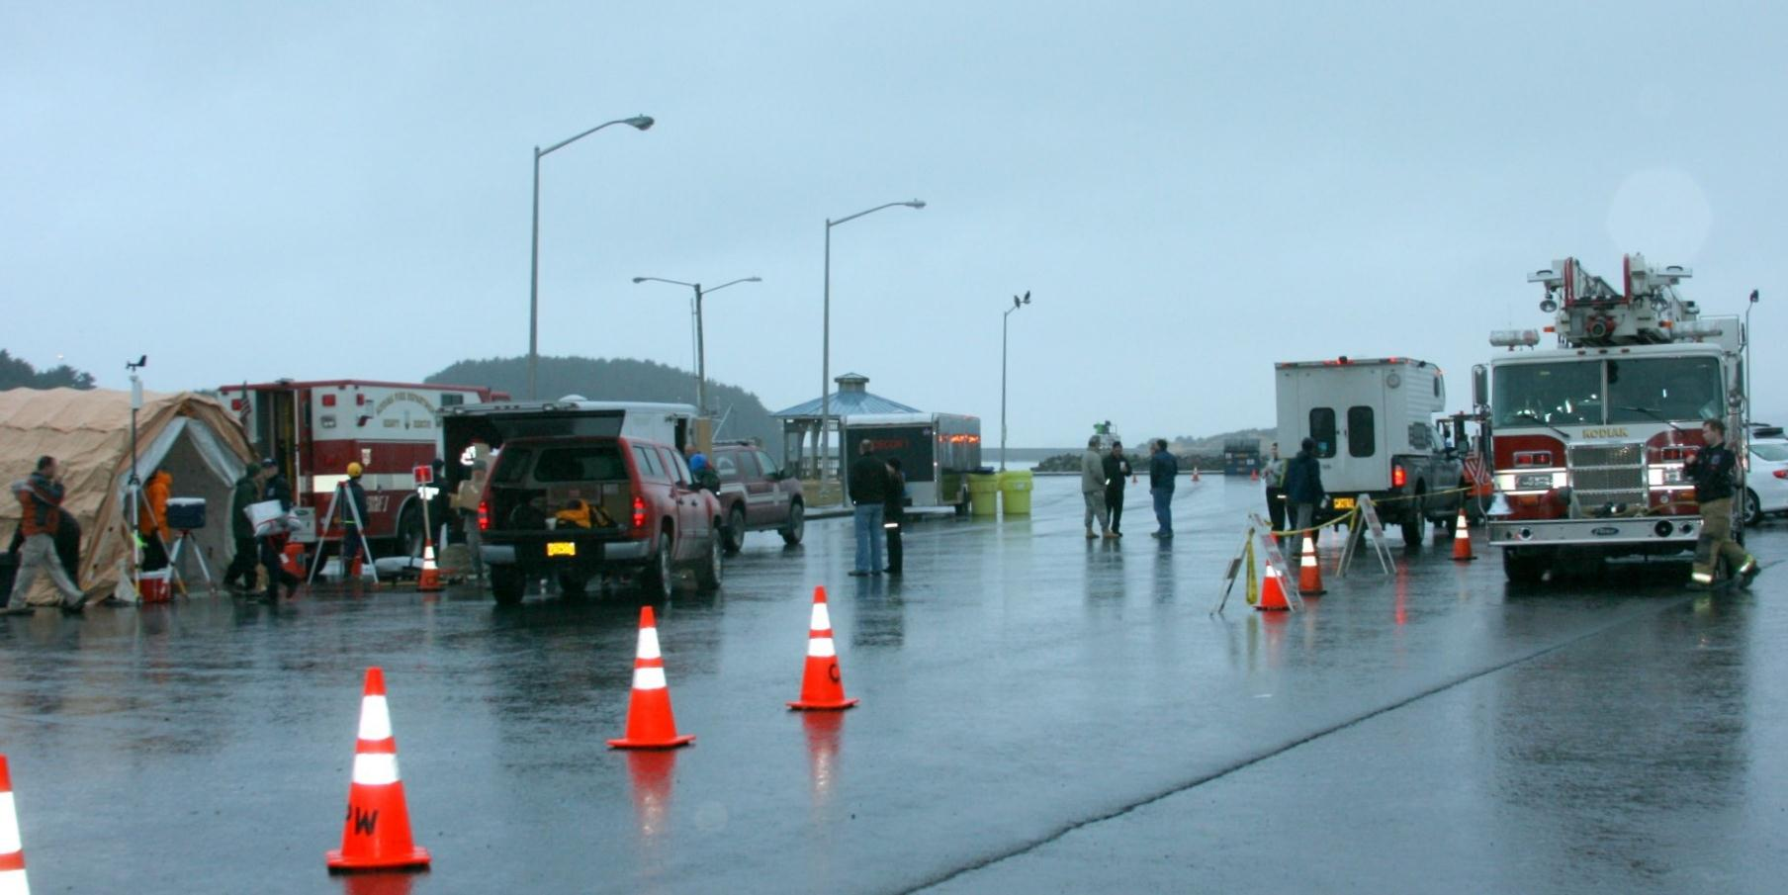
Field Exercise Play Area

Slide 10
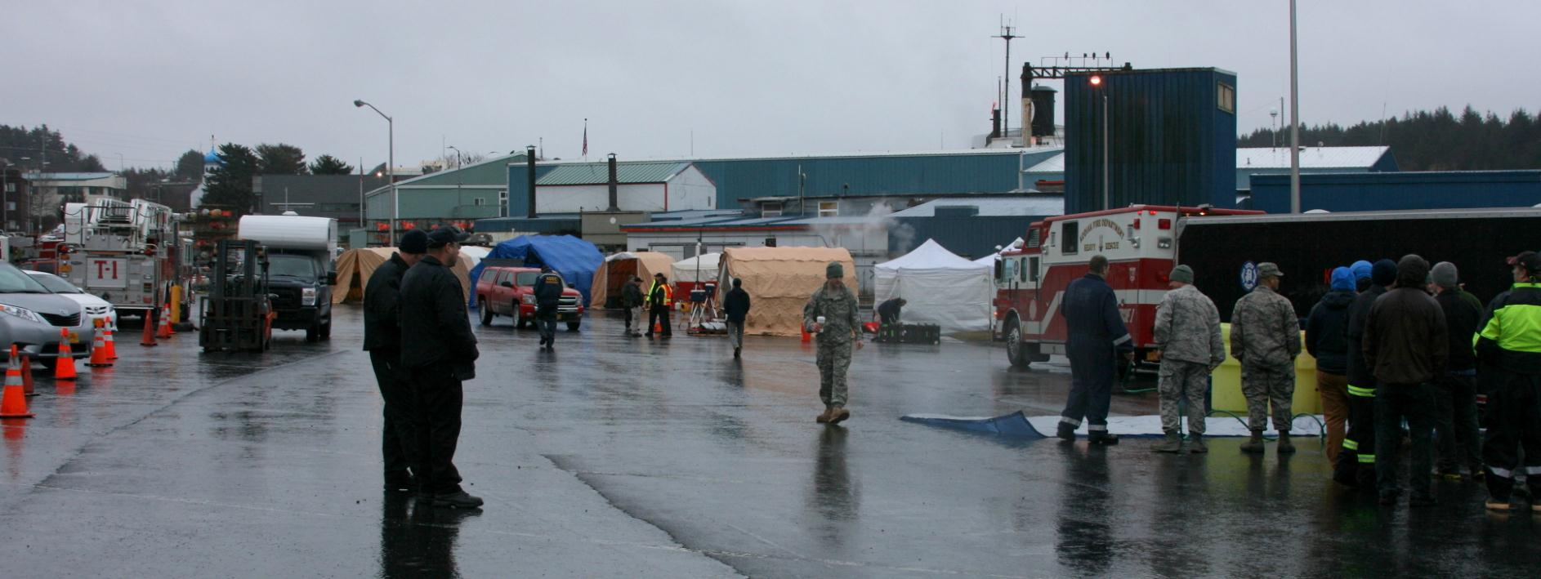
Field Exercise Play Area

Slide 11
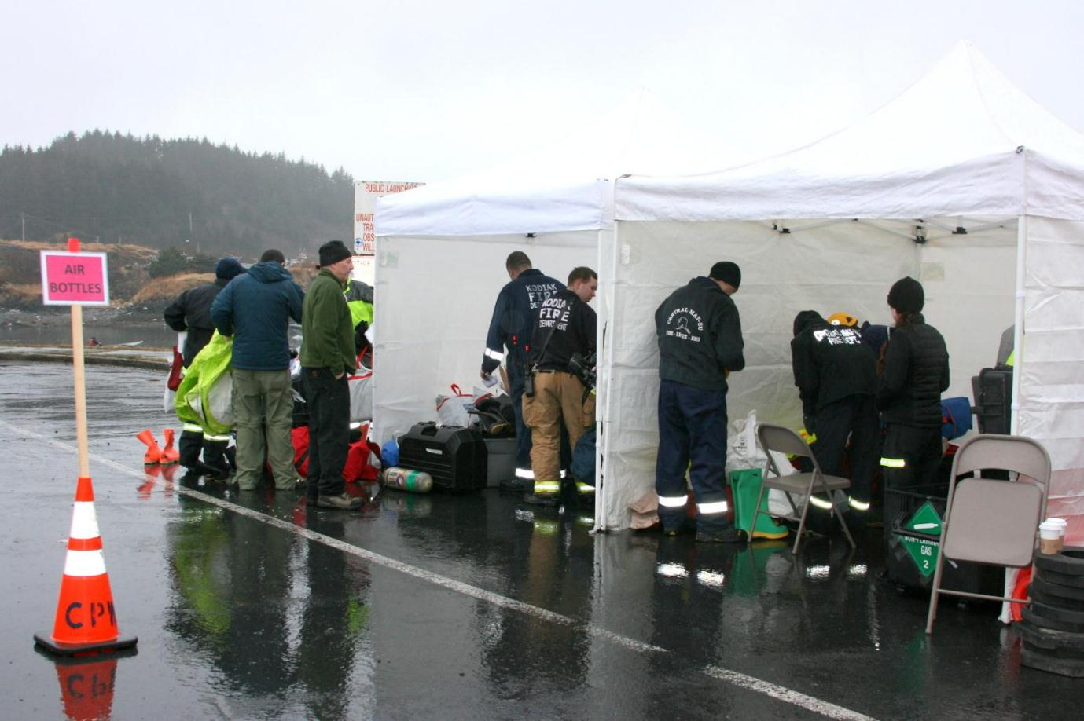
Equipment Shelters

Slide 12
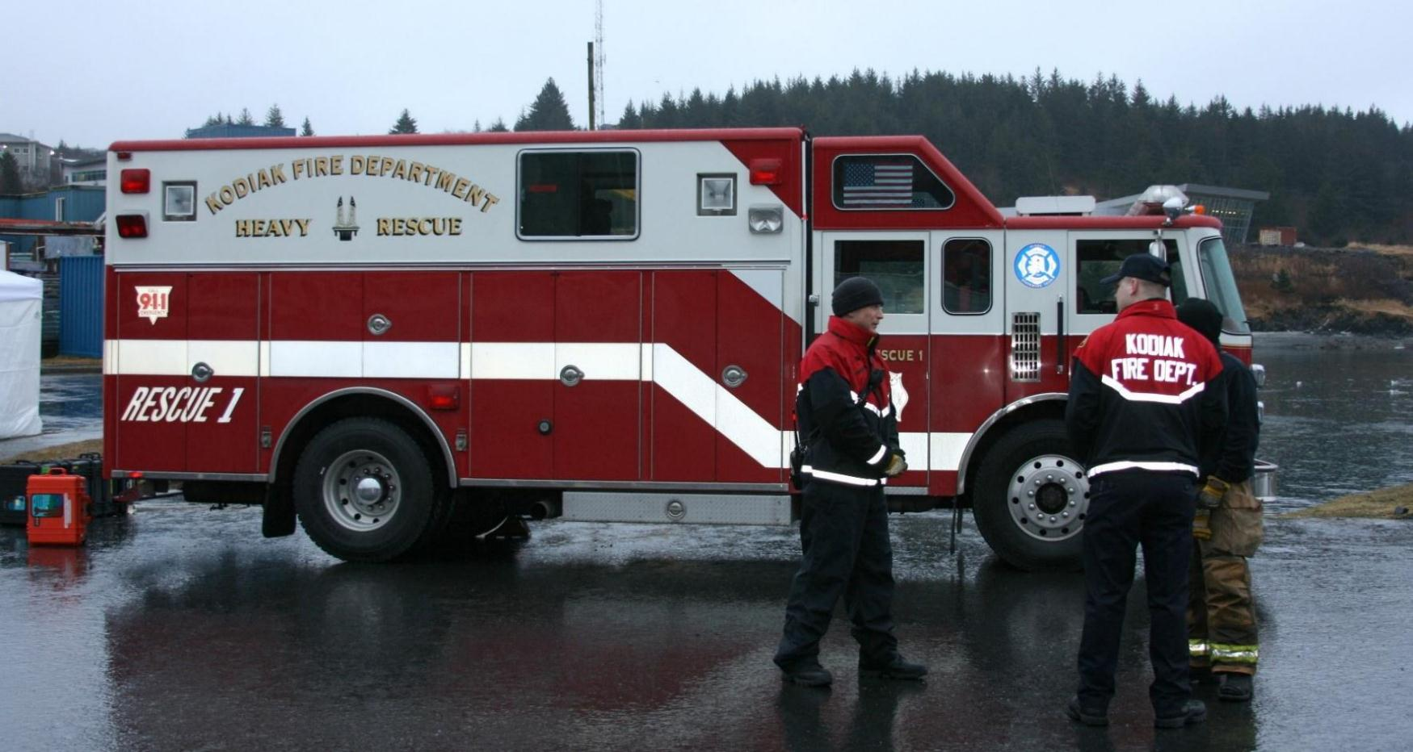
Kodiak Mobile Command

Slide 13
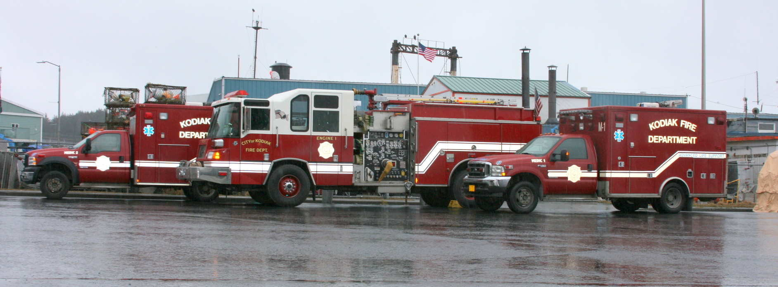
Kodiak FD on Standby

Slide 14
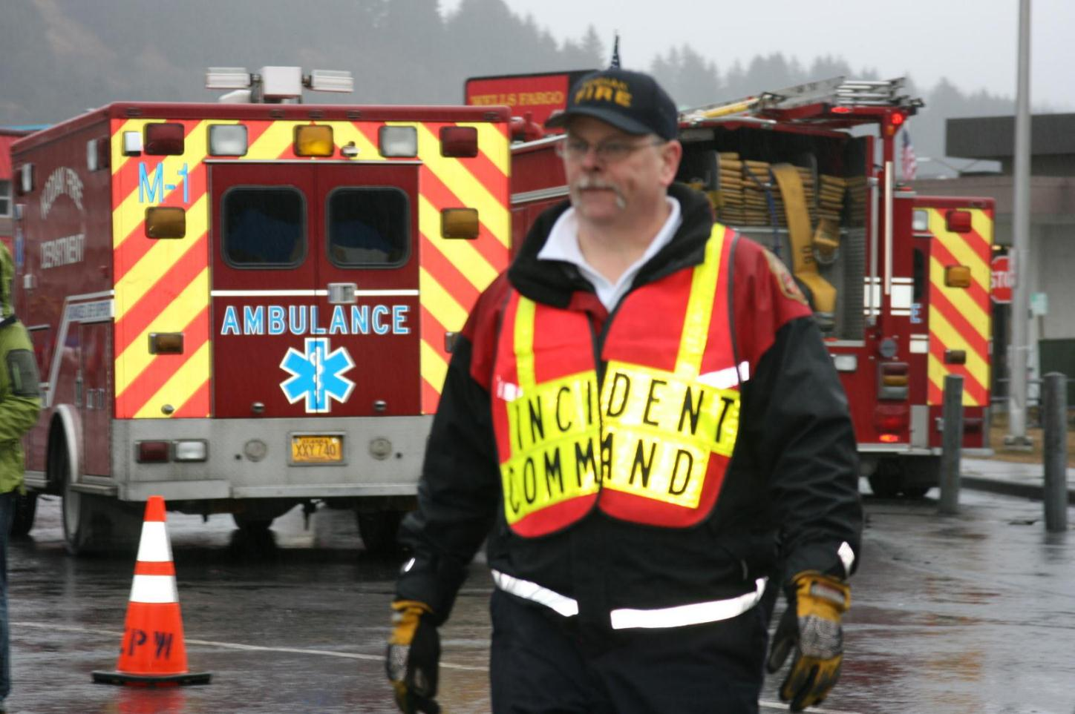
Jim Mullican – Incident Commander

Slide 15
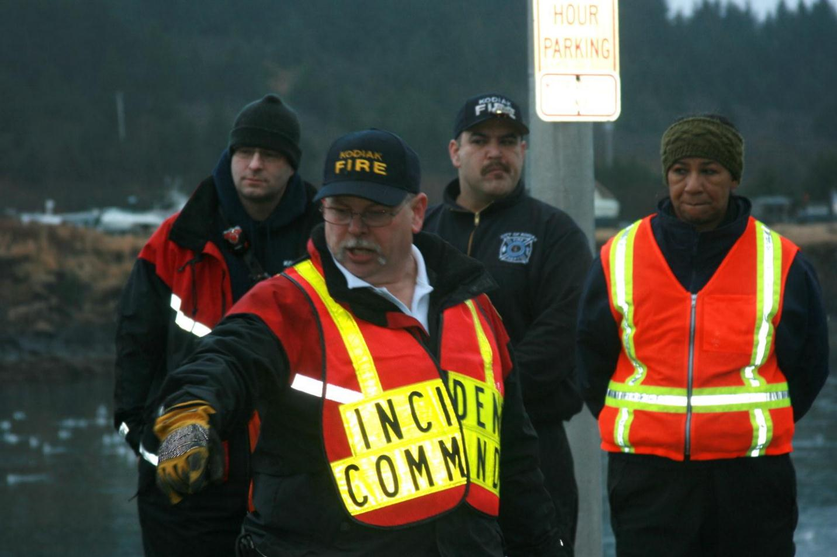
Jim Mullican – In Command

Slide 16
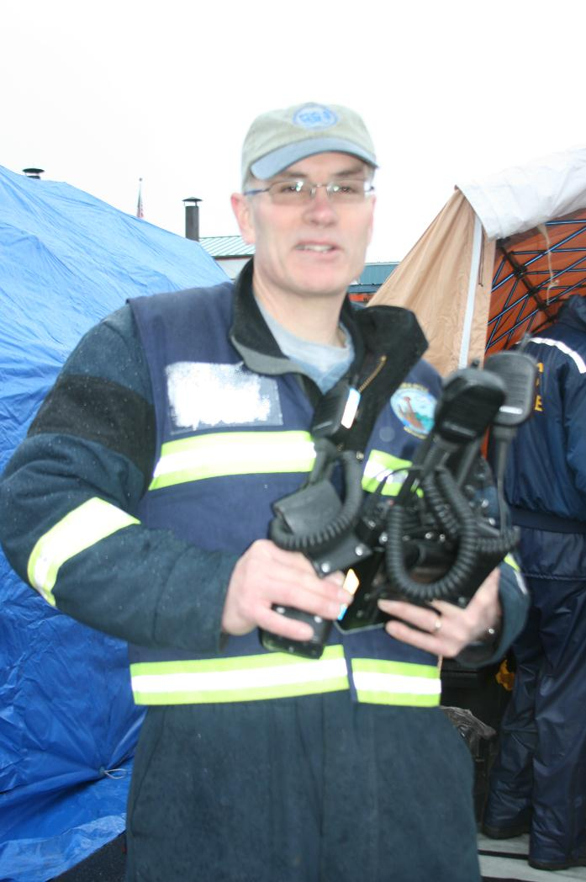
DEC Provided ALMR Radios For Each Hazmat Team Member

Slide 17
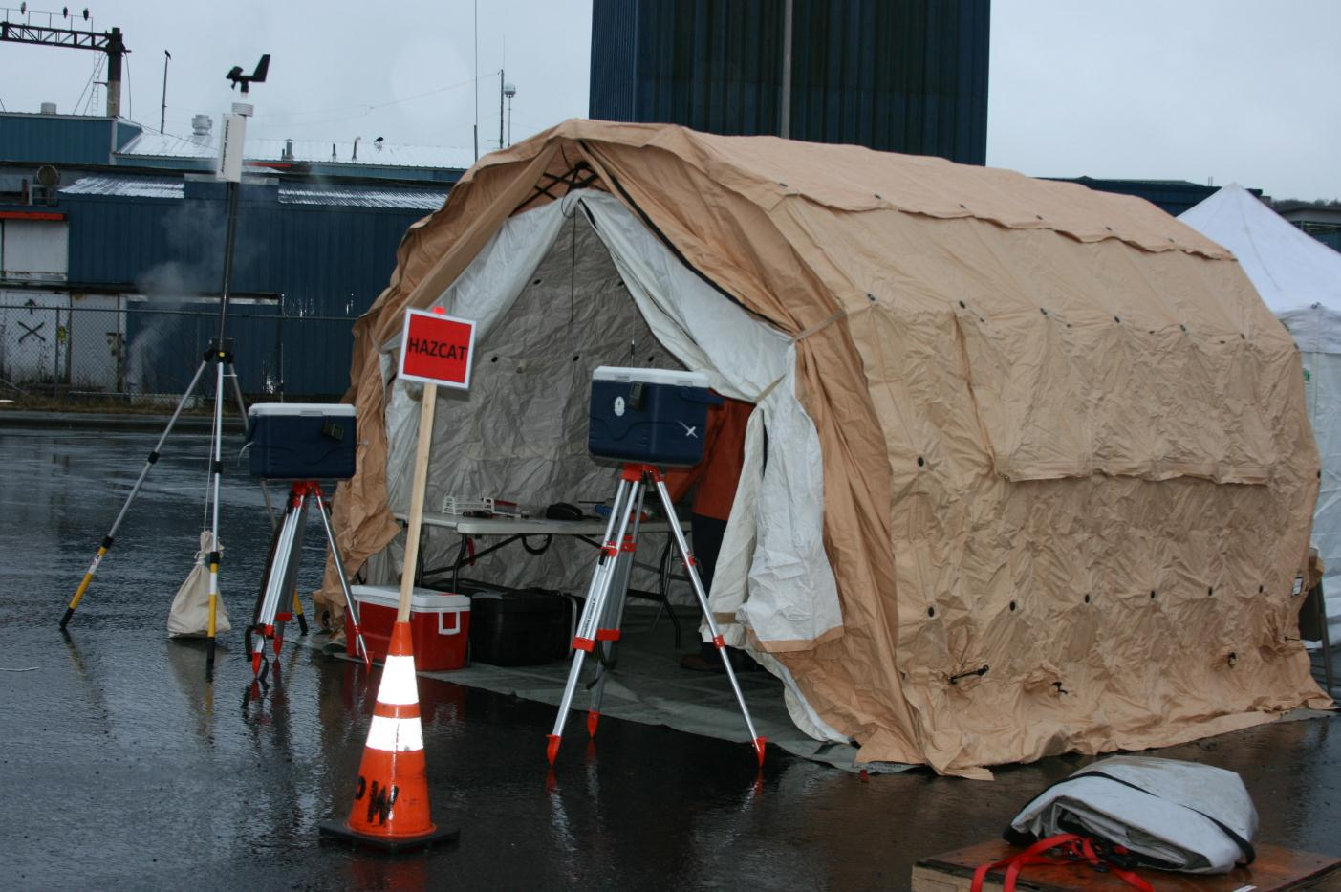
EPA HAZCAT Demo Site

Slide 18
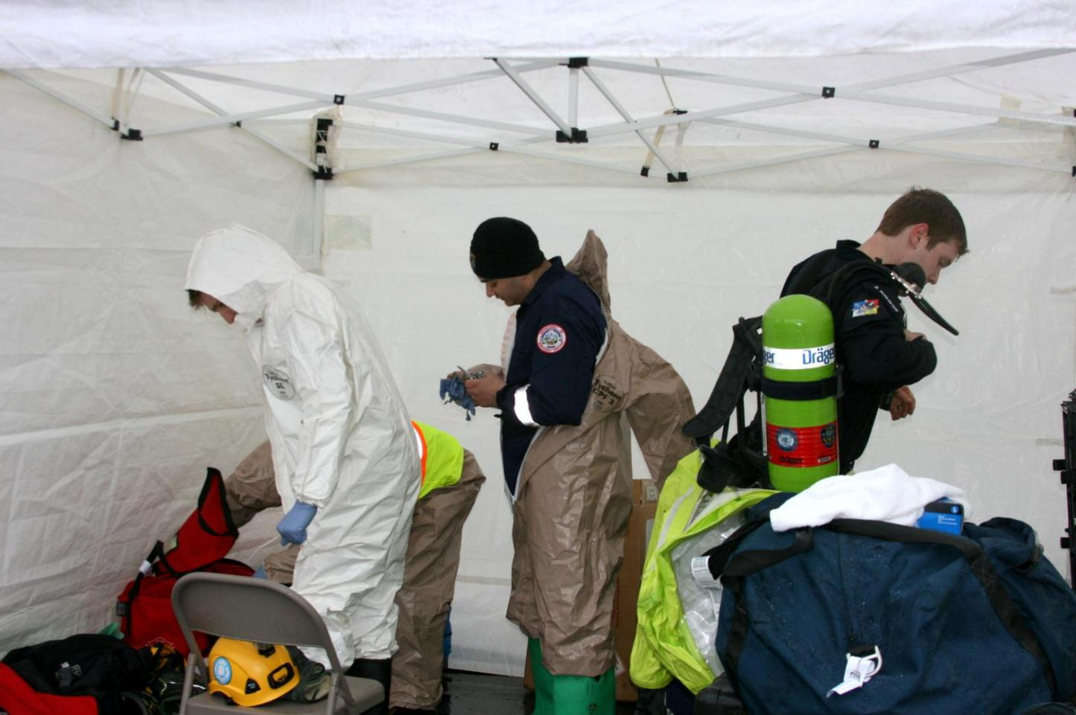
Suiting Up

Slide 19
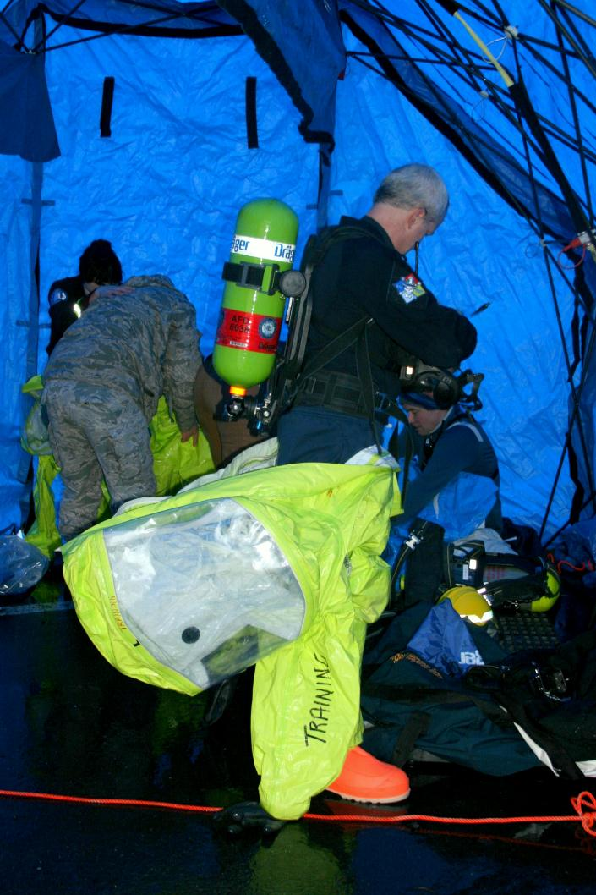
Suiting Up

Slide 20
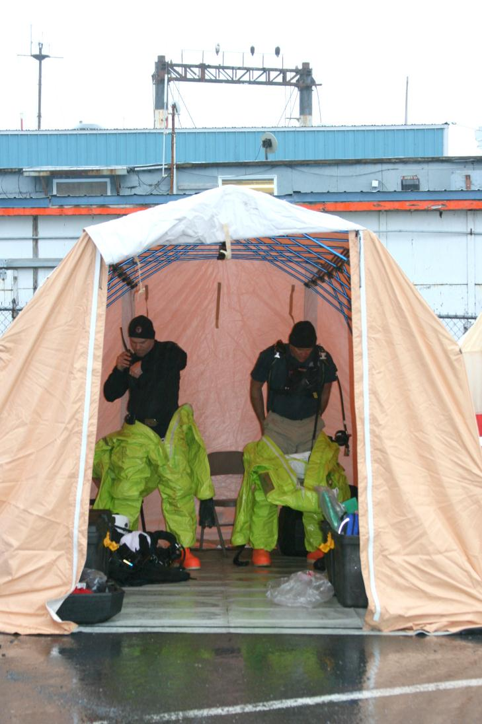
Suiting Up

Slide 21
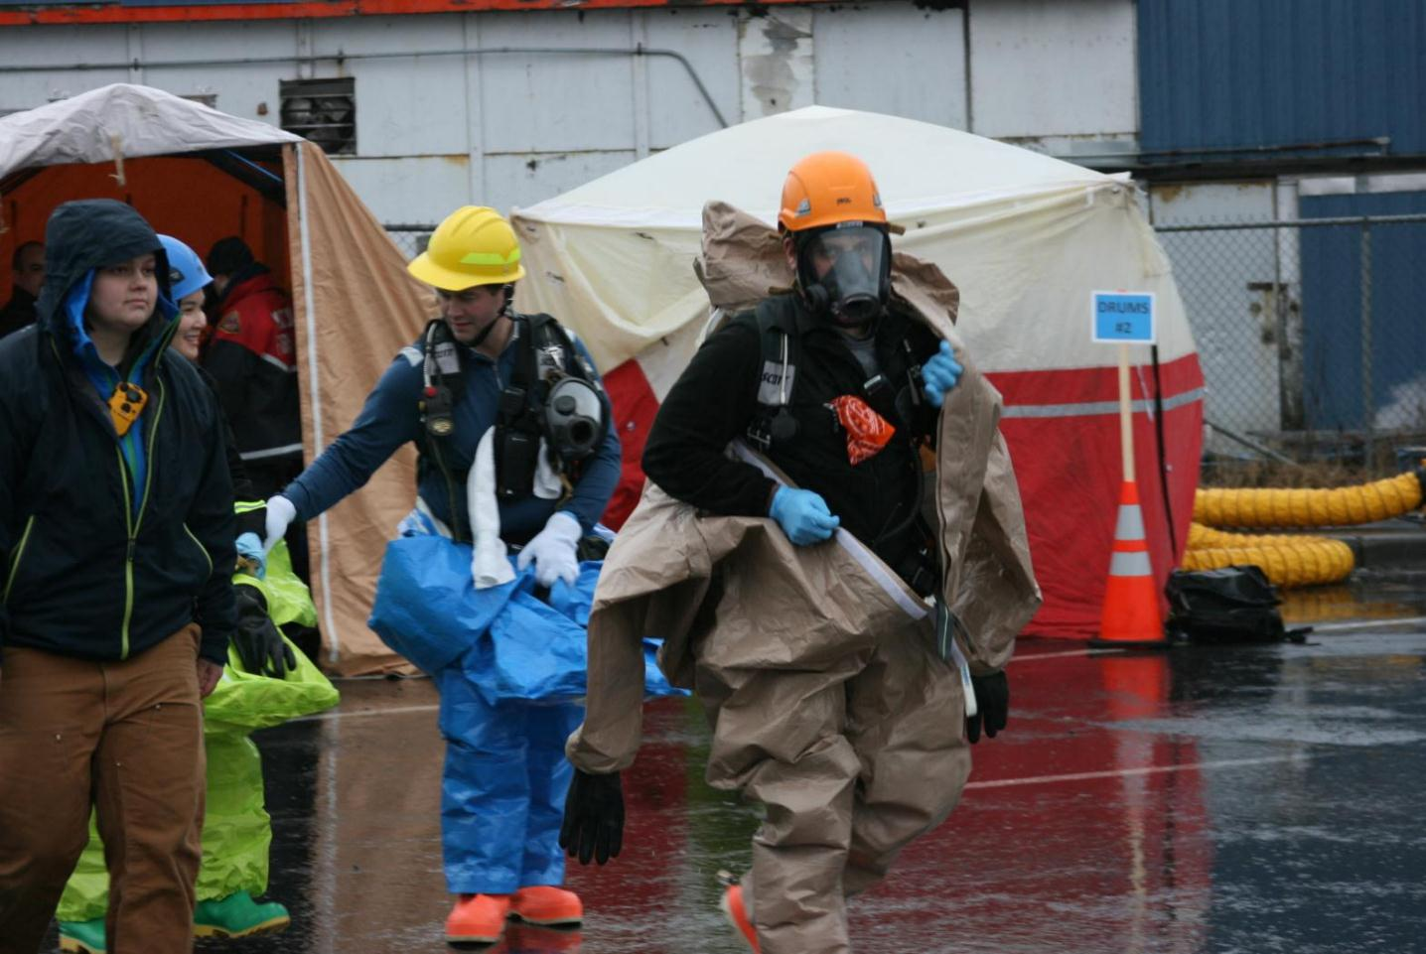
Heading to Prop Site

Slide 22
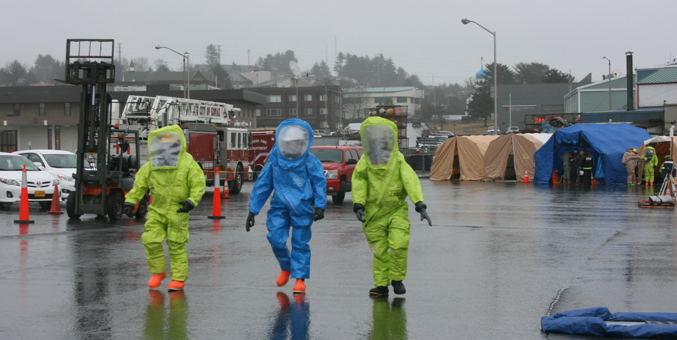
Heading to Prop Site

Slide 23
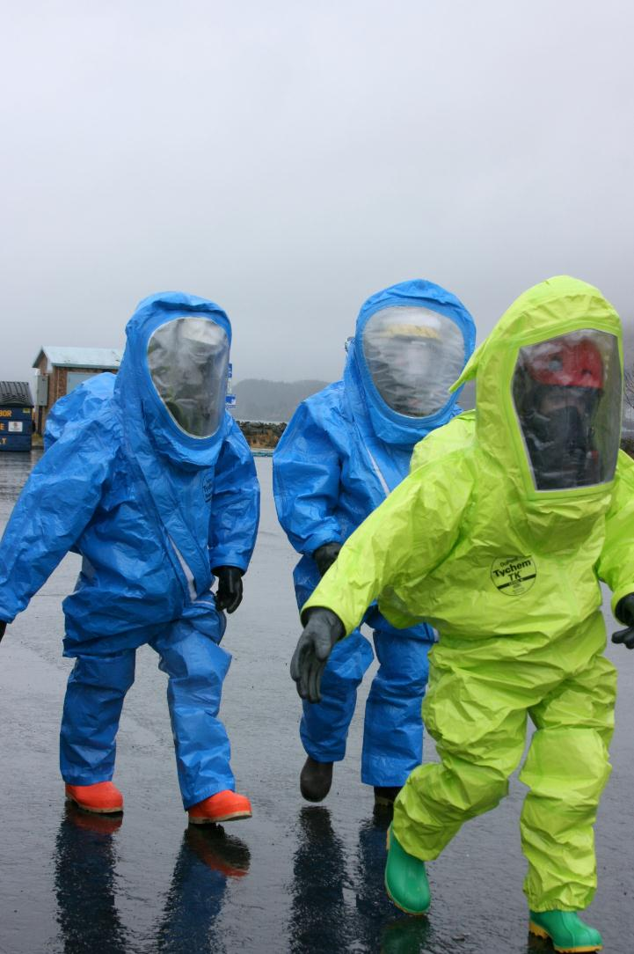
Heading to Prop Site

Slide 24
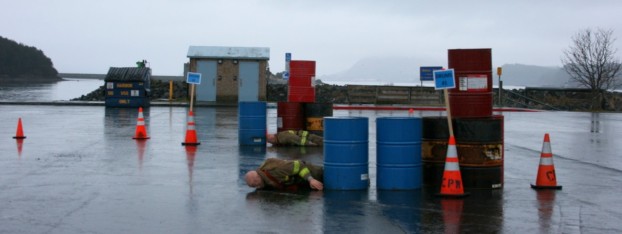
Drum Response Sites

Slide 25
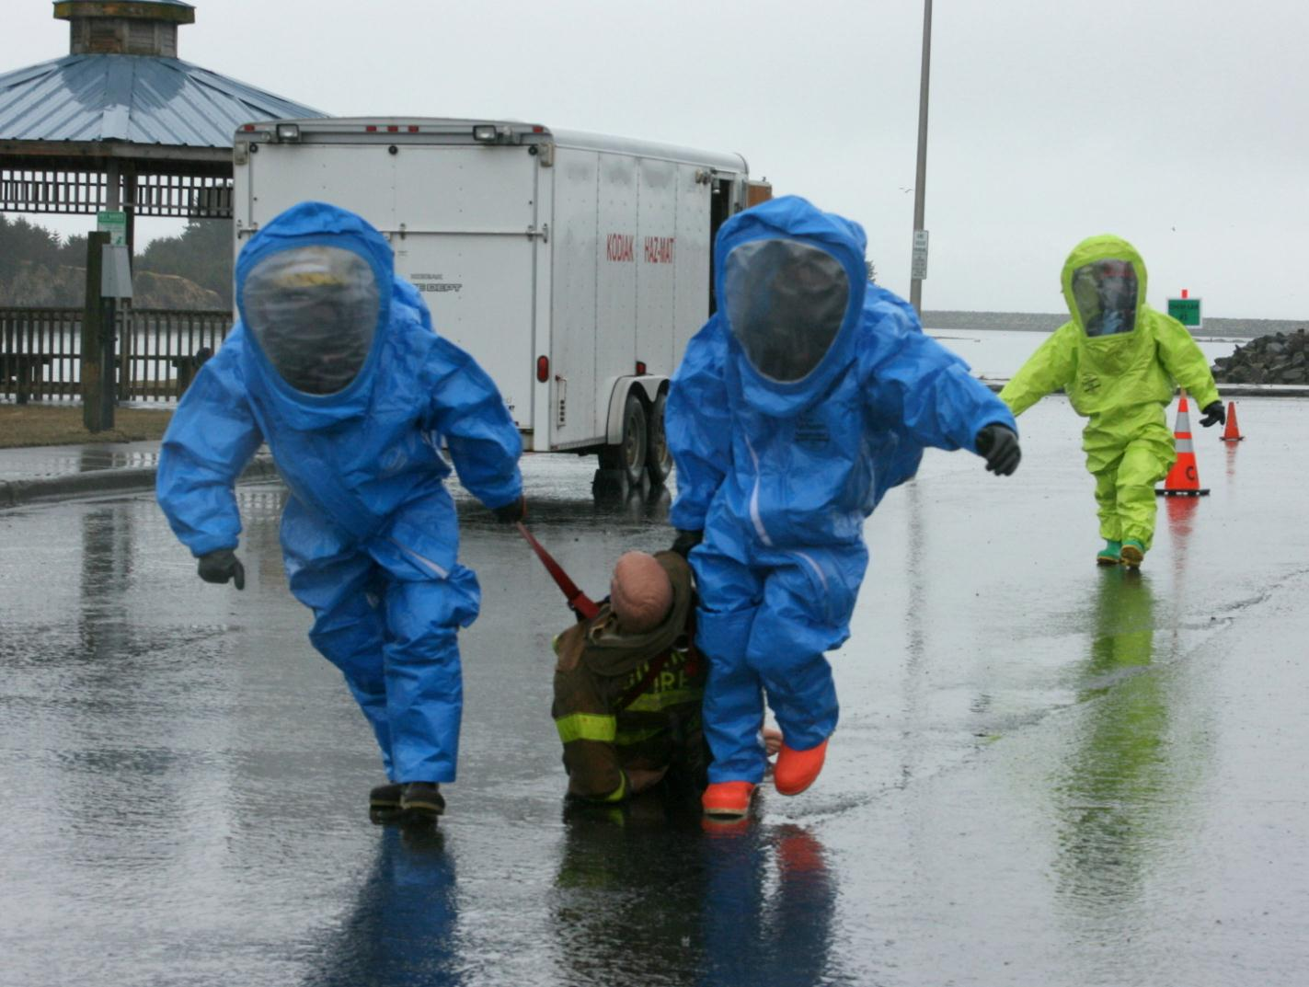
Victim Rescue

Slide 26
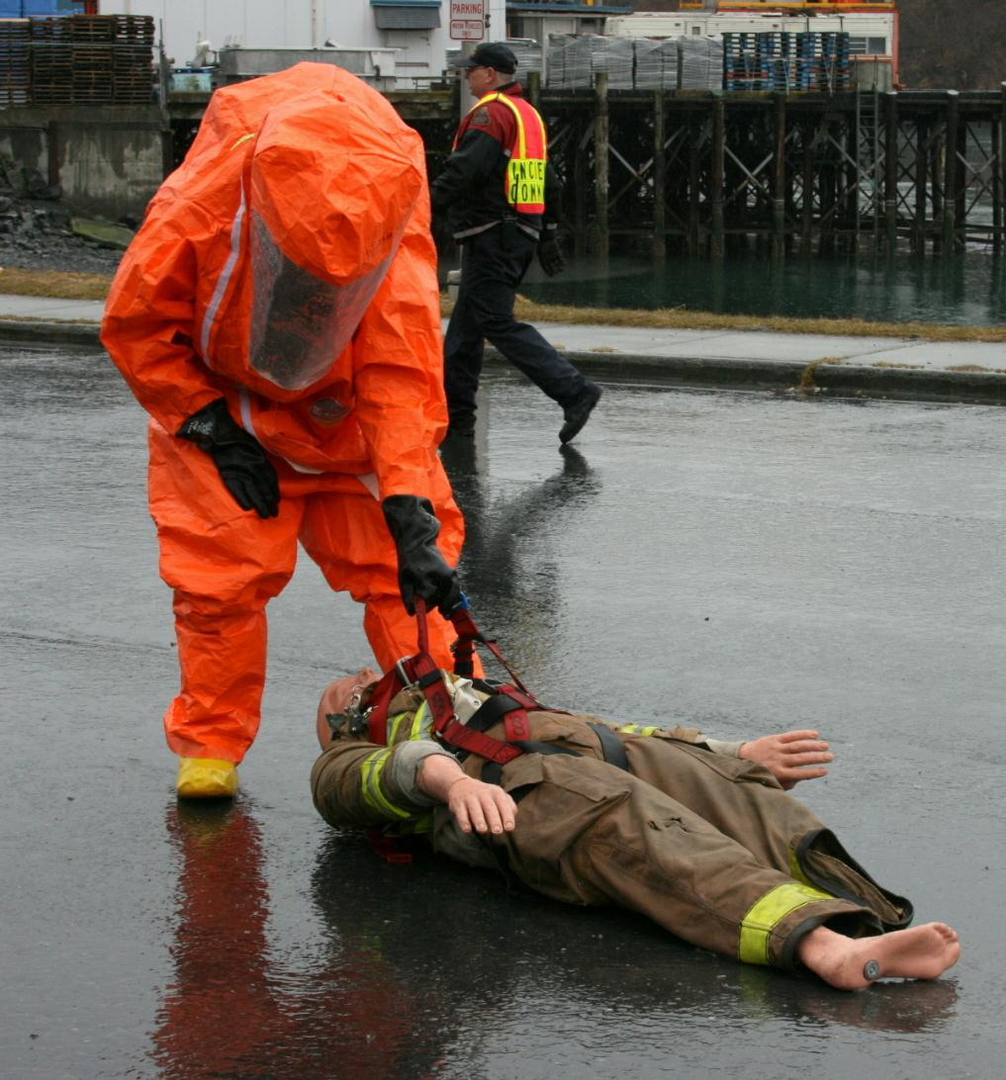
Victim Rescue

Slide 27
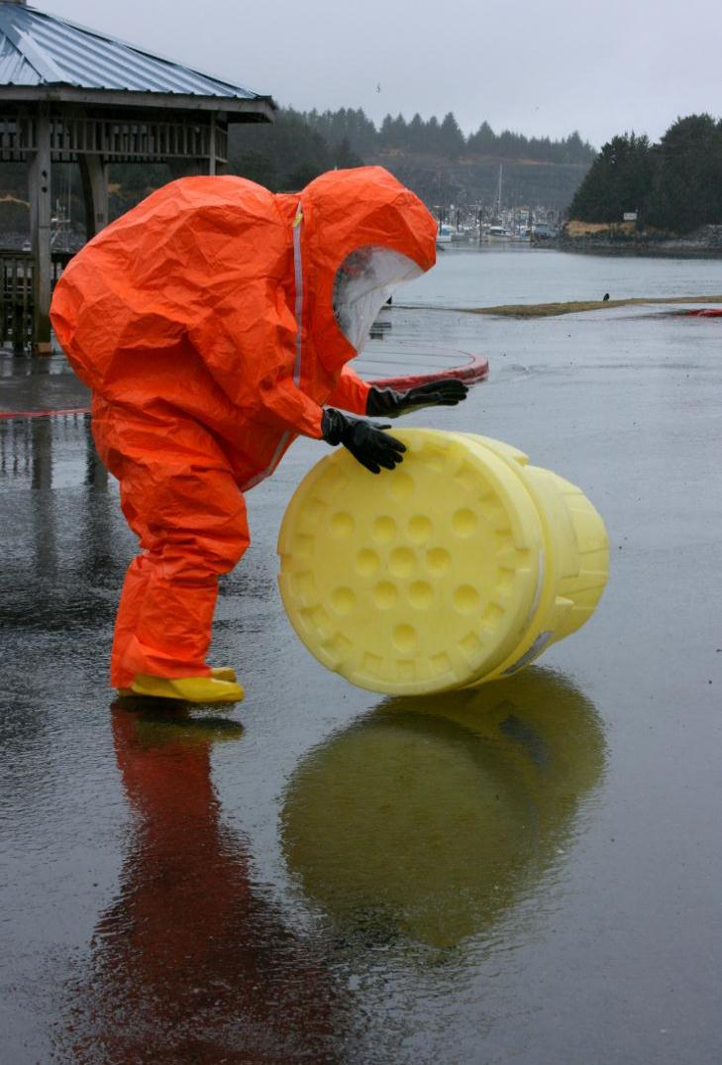
Overpack Drum

Slide 28
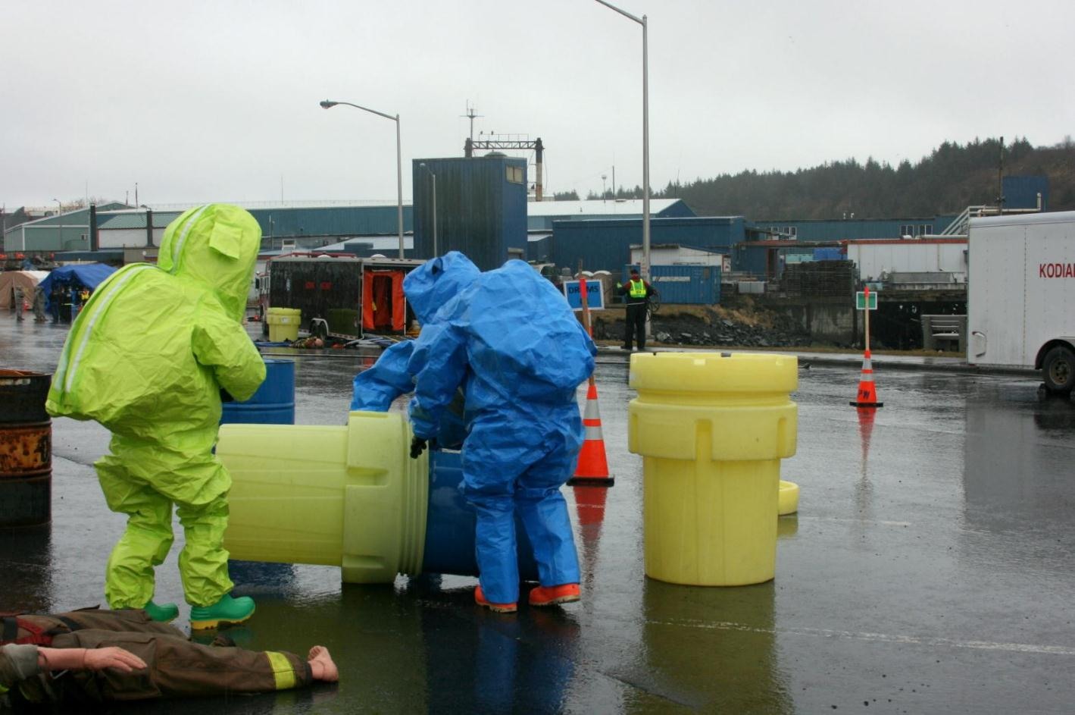
Putting 55-Gal Drum Into Overpack

Slide 29
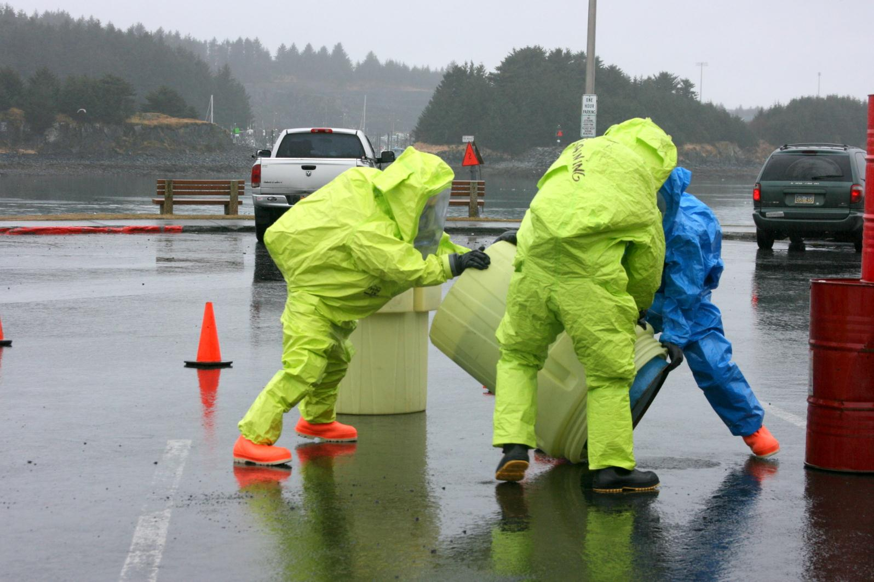
Overpacking
55-Gal Drum

Slide 30
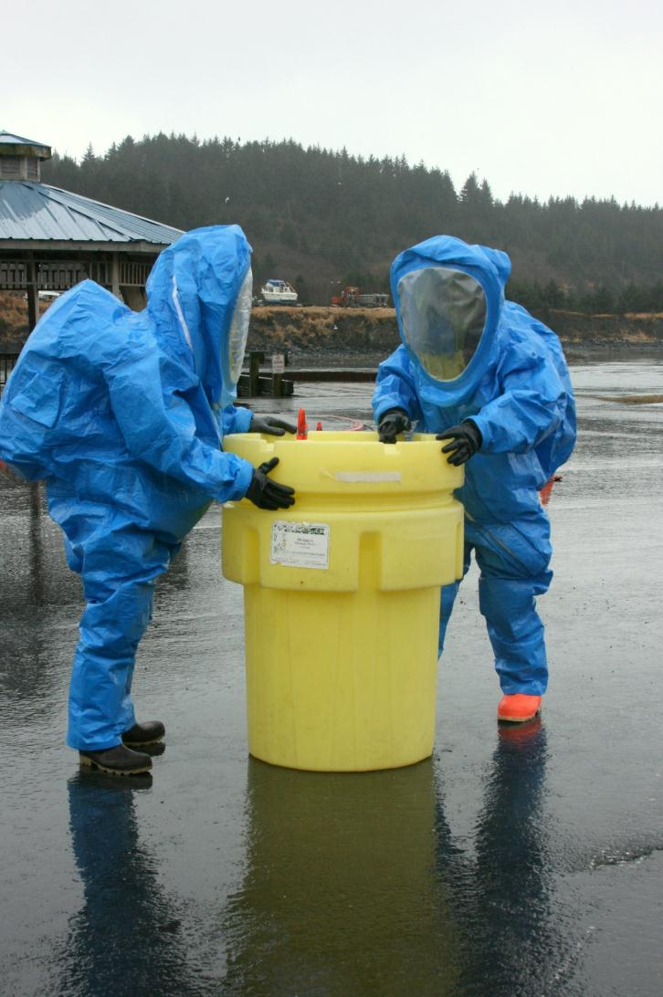
Screw-On Lid

Slide 31
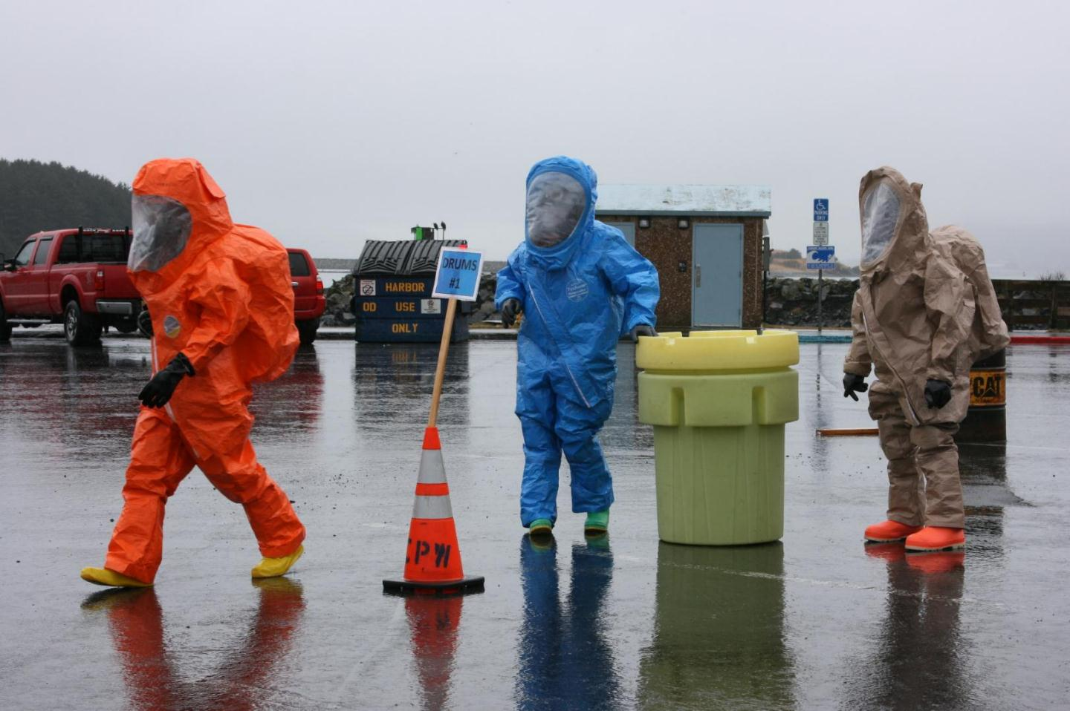
Whew! I’m Done

Slide 32
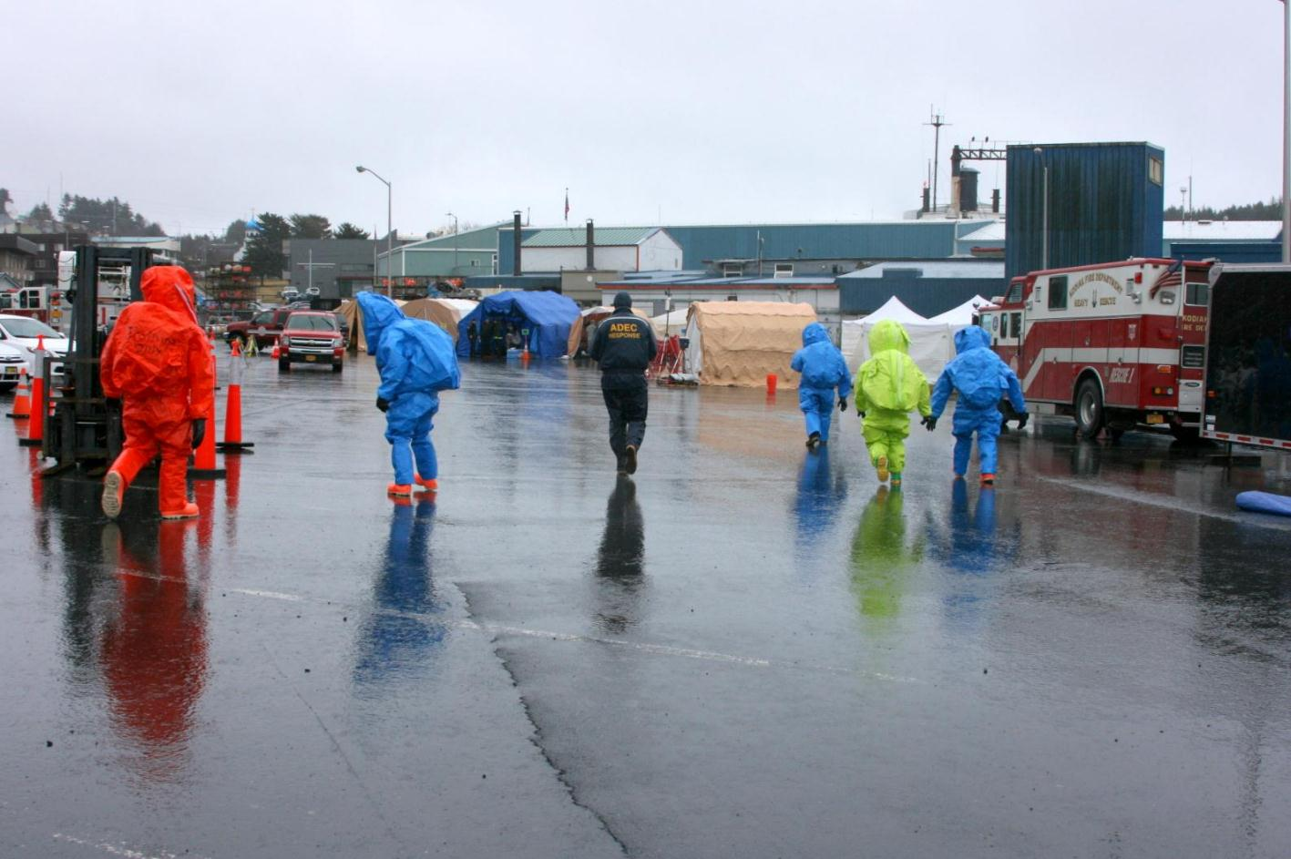
Returning to Suit-Up Tents

Slide 33
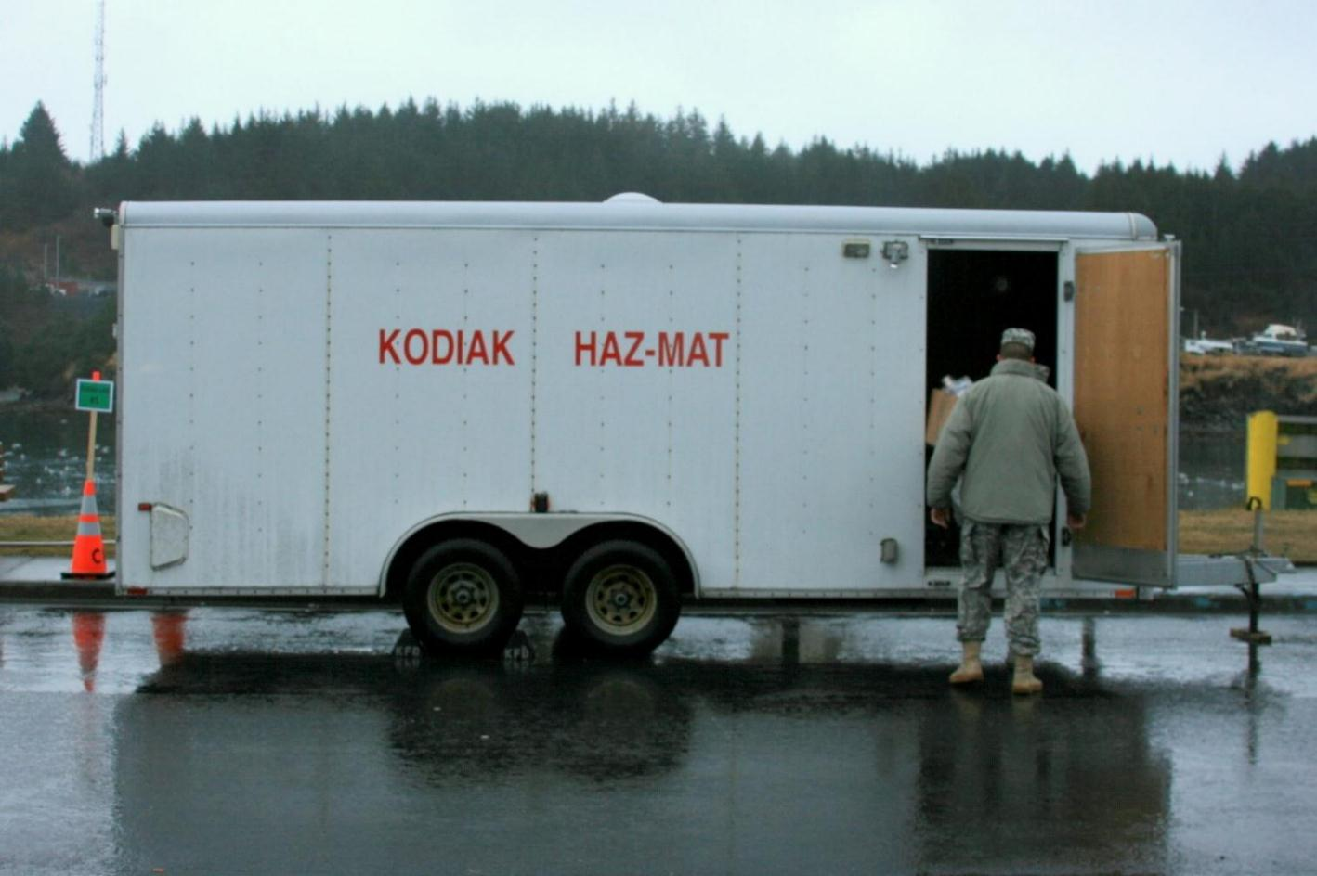
Mobile Chemical Lab Response Site

Slide 34
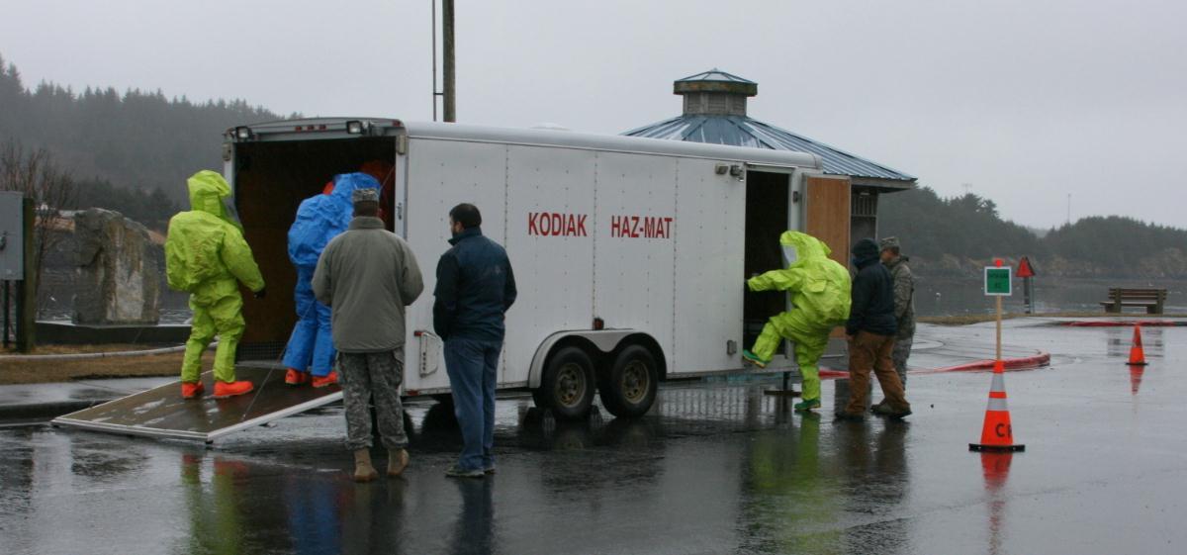
2 Labs in One

Slide 35
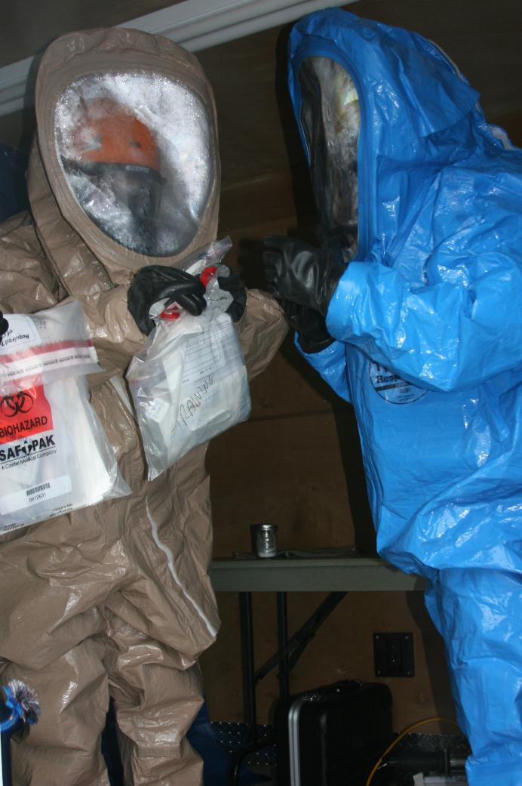
Using State Environmental
Sampling Kits.
For Biological & Chemical

Slide 36
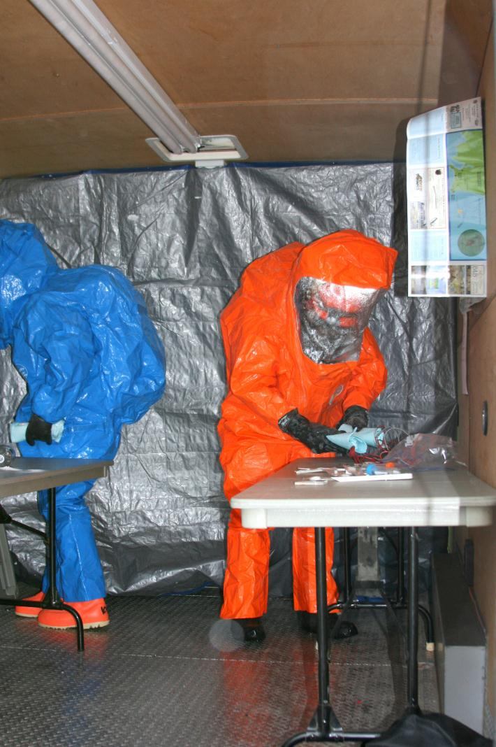
Collecting Samples
White Powder and Liquid

Slide 37
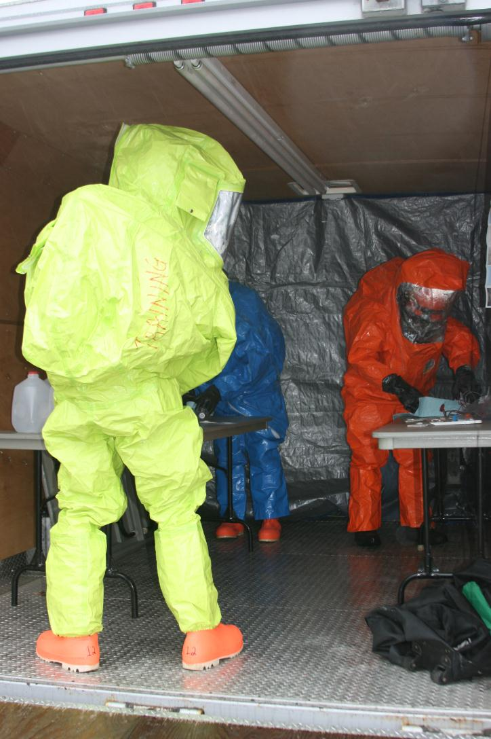
Sample Collection

Slide 38
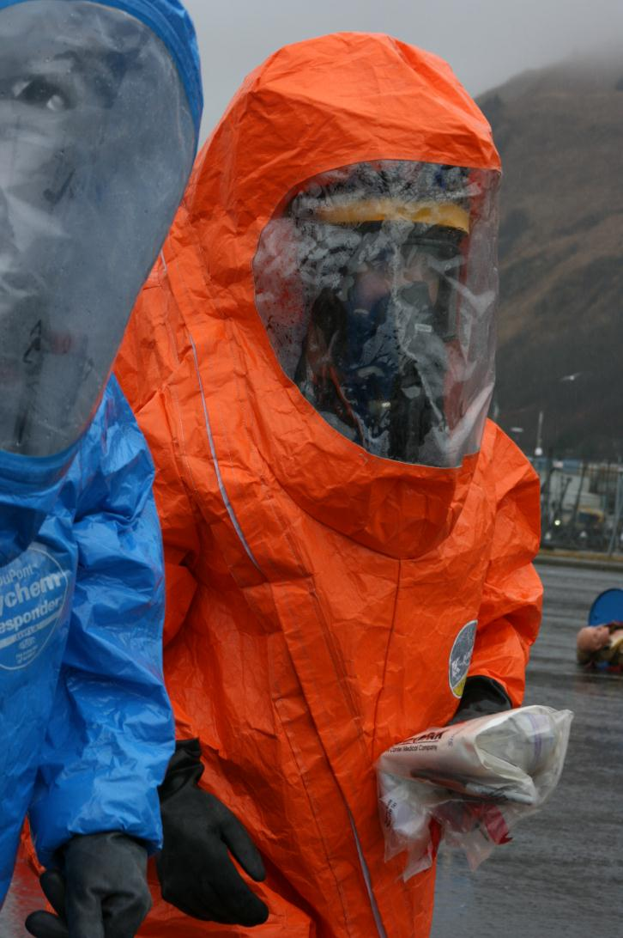
Heading to Decon
With Samples

Slide 39
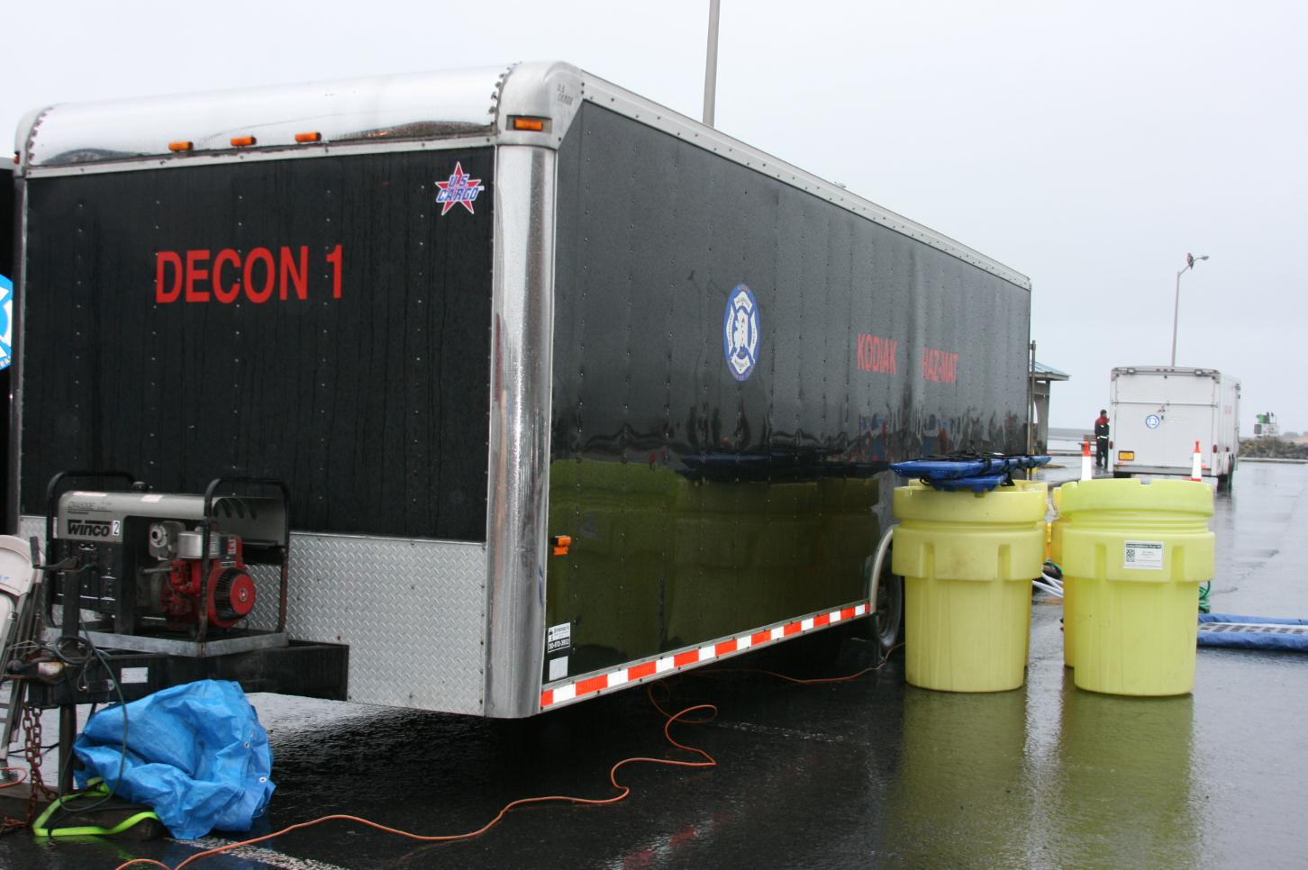
Wet Decontamination Unit

Slide 40
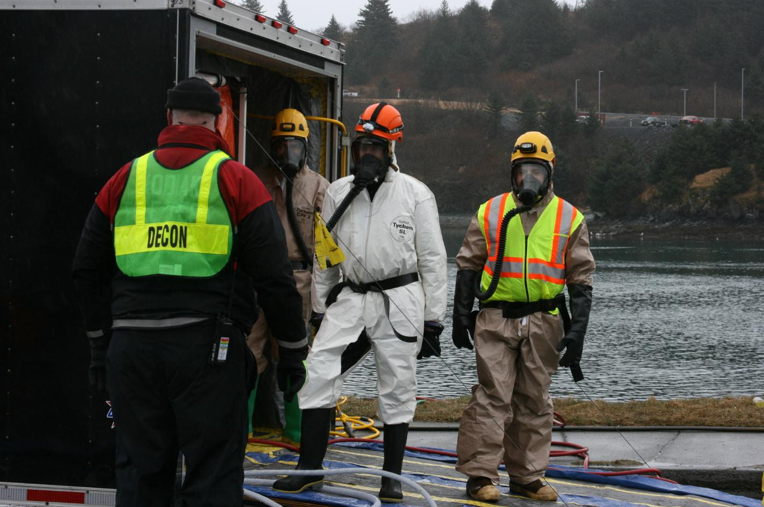
The Decon Crew

Slide 41
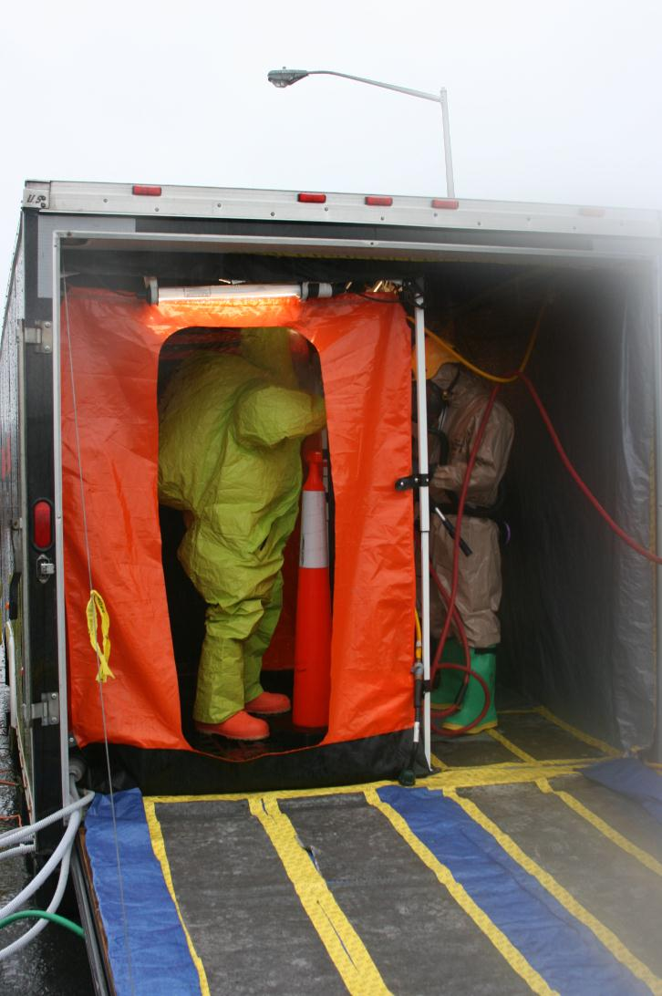
Wet Decontamination Unit

Slide 42
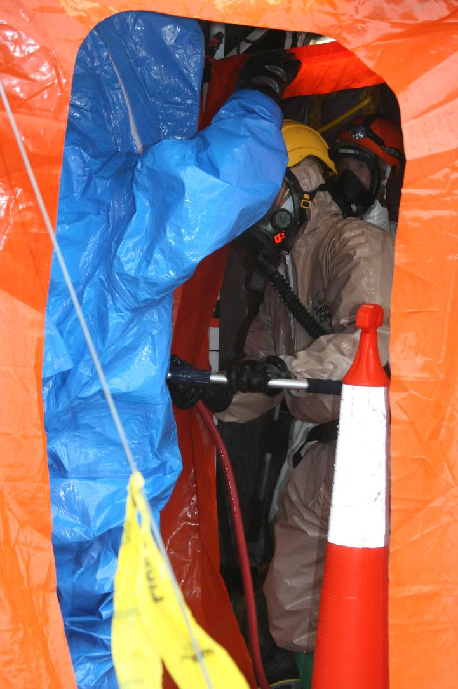
Wet Decon Scrub Down

Slide 43
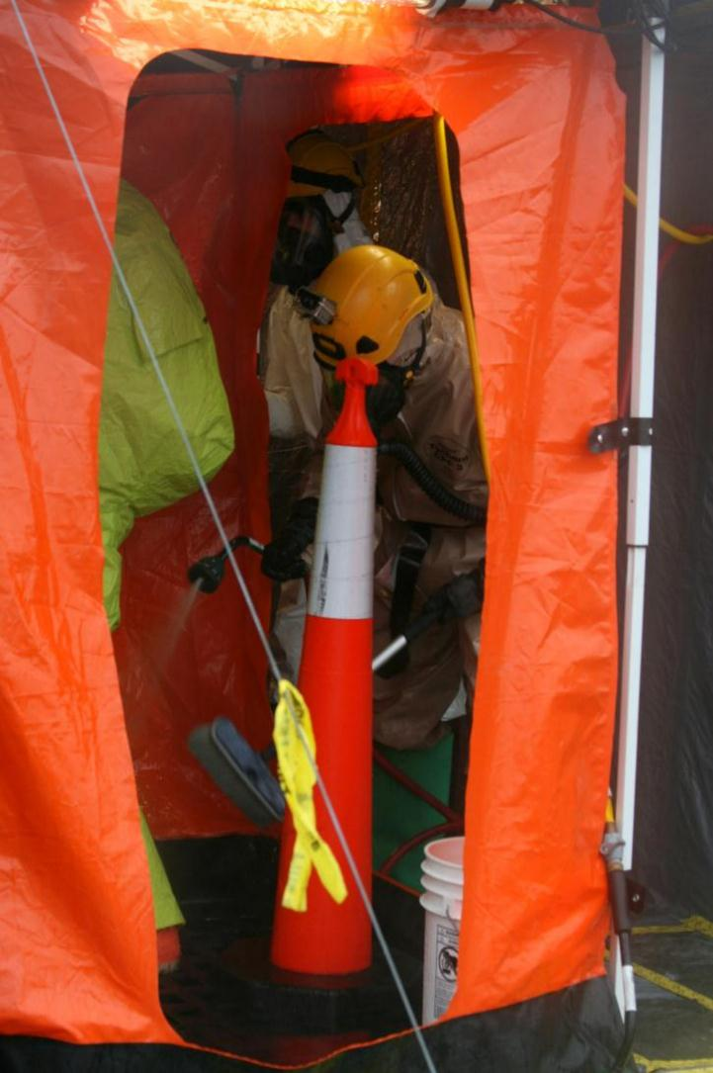
Wet Decon Wash

Slide 44
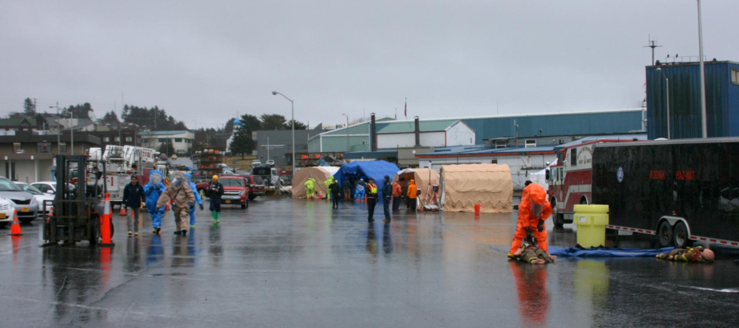
Play Area Overview

Slide 45
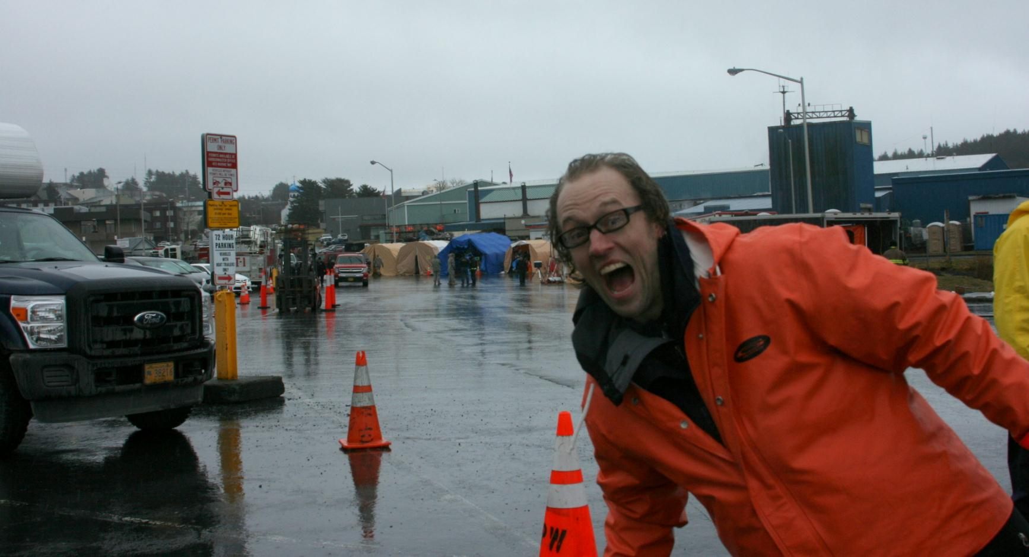
There’s One in Every Crowd

Slide 46
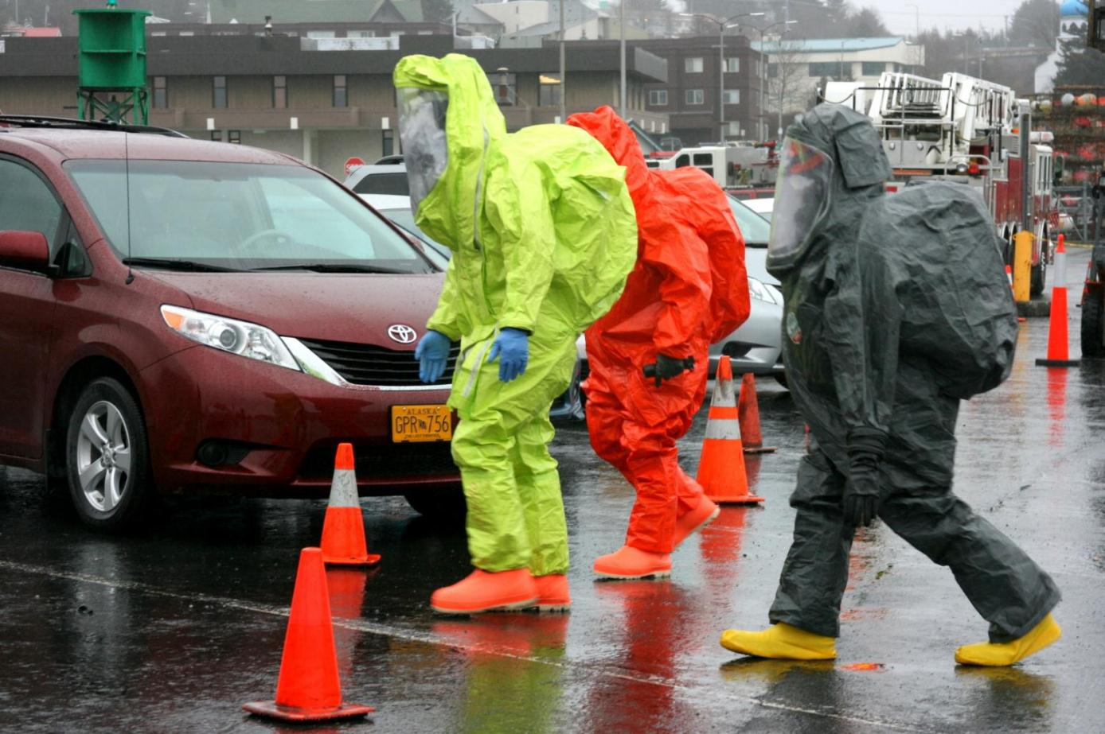
Entry Team Headed to F/V Prop

Slide 47
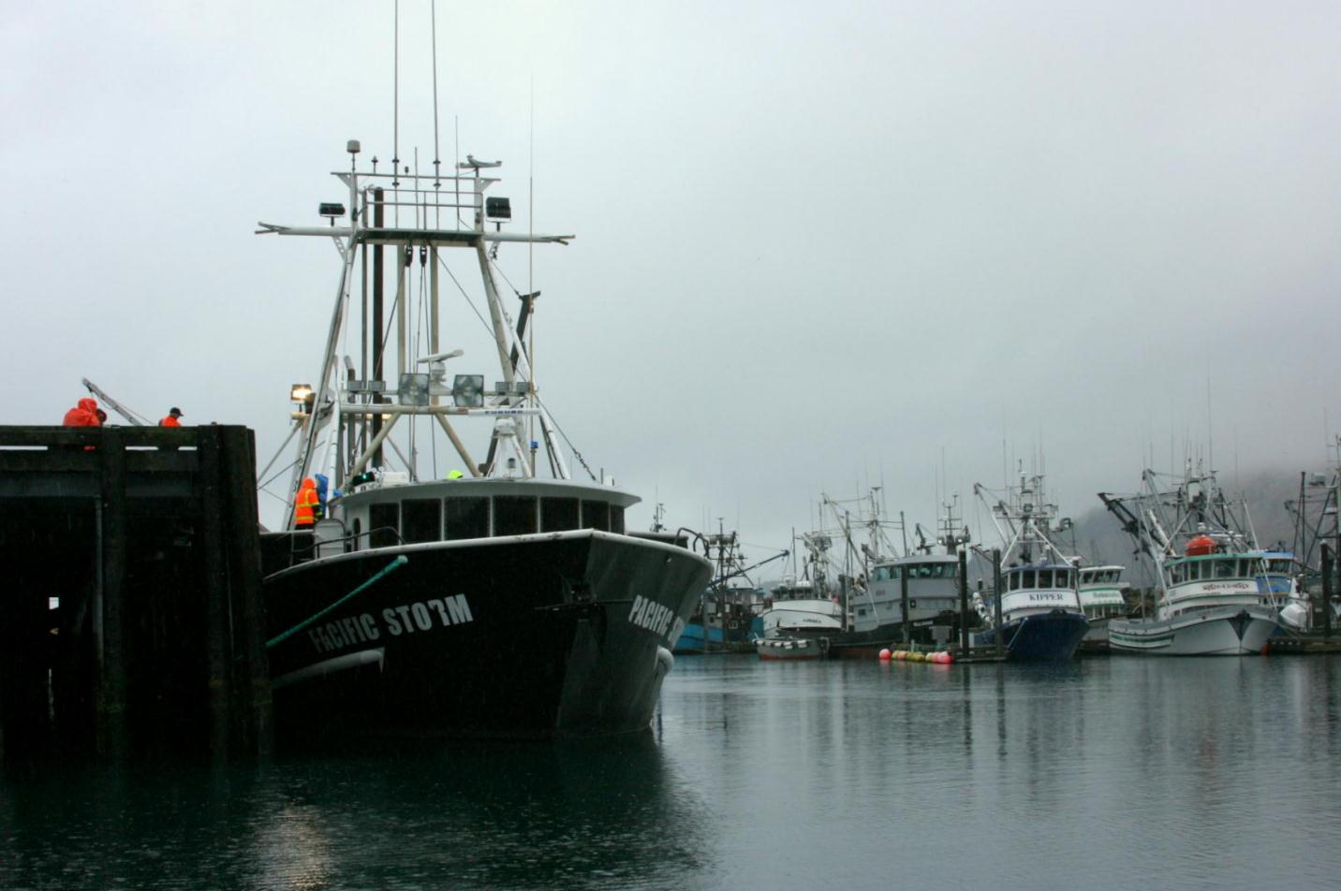
F/V Pacific Storm – Refrigerant Leak Prop

Slide 48
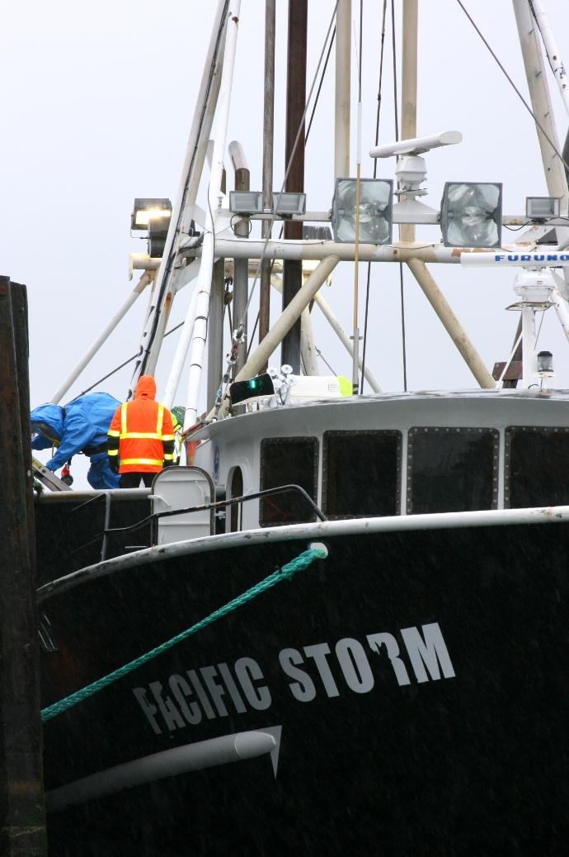
F/V Pacific Storm – Refrigerant Leak Prop

Slide 49
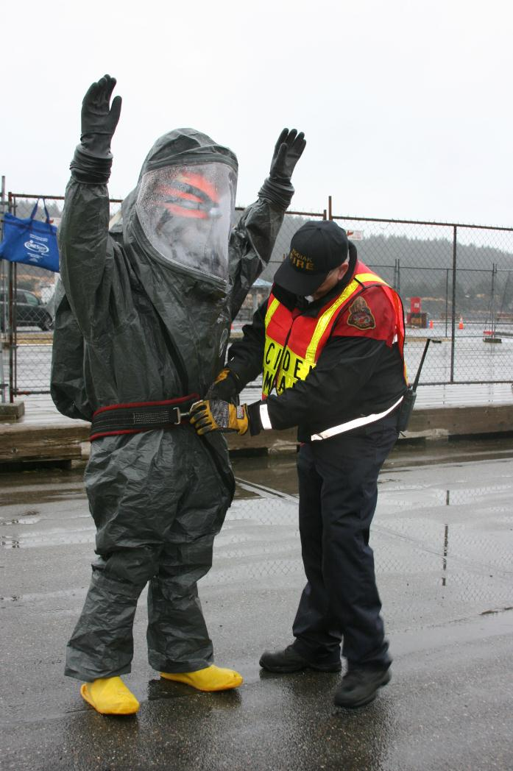
Attaching Safety Harness
To Access Boat

Slide 50
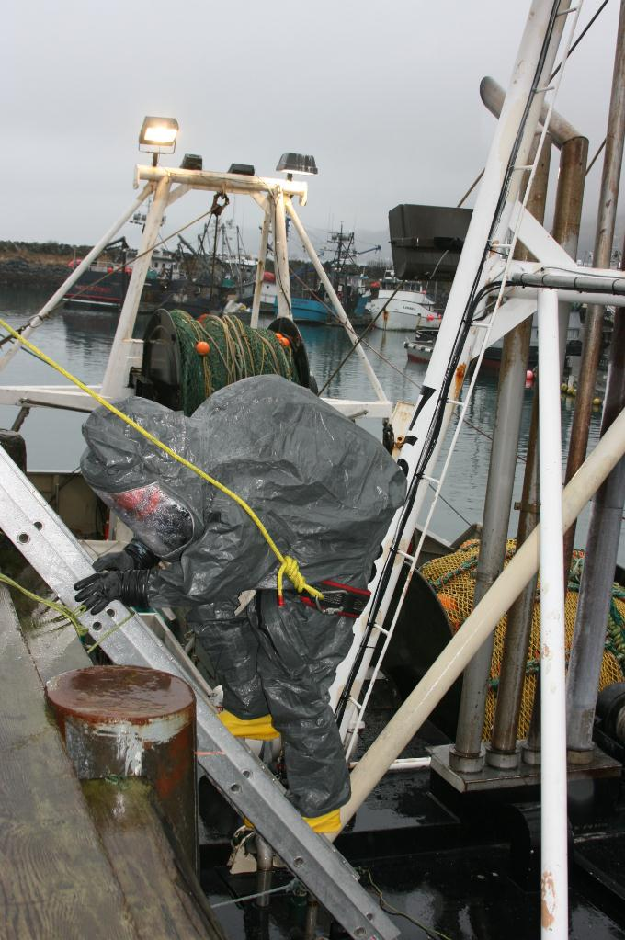
Down Ladder

Slide 51
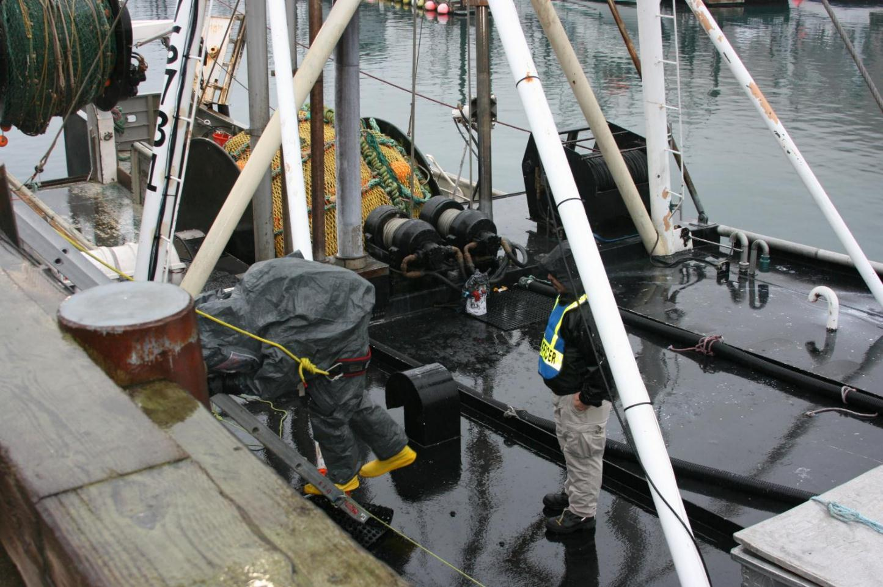
Down Ladder

Slide 52
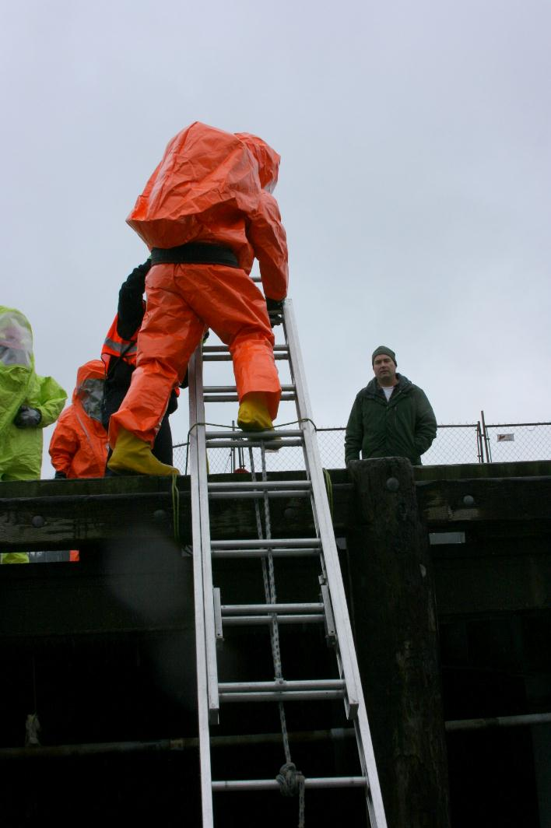
Down Ladder

Slide 53

Down Ladder

Slide 54

Made it

Slide 55

Down Ladder to Lower Deck

Slide 56

Down Ladder to
Lower Deck

Slide 57

Down Internal Stairs
to Engine Room

Slide 58

Down Internal Stairs
to Engine Room

Slide 59

Cutting Power at Breaker Box

Slide 60

Exiting Engine Room
Up Internal Stairs

Slide 61

Exiting Engine Room
Up Internal Stairs

Slide 62

Up Ladder to
Upper Deck

Slide 63

Up Ladder Onto Dock

Slide 64

I’m the King of The World!

Slide 65

Questions?

