Slide 1
Sampling refresher

Slide 2

Site characterization
What am I dealing with

Slide 3

Site characterization
Identify all the hazards

Slide 4

Site characterization
Be systematic

Slide 5


Pictures
Before and after
Organized

Slide 6


Pictures
Picture quality
Take more pictures than you think you need
Have extra SD cards

Slide 7
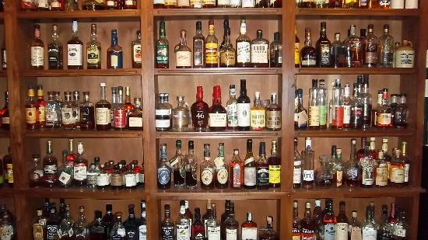
Sample selection
Choose the best 1 or 2 samples
Sample in the proper order

Slide 8
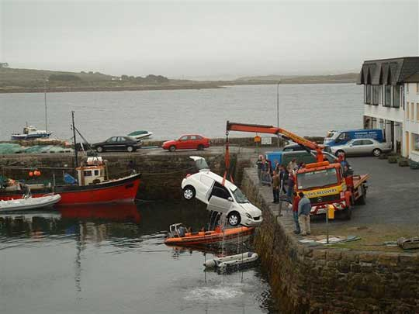
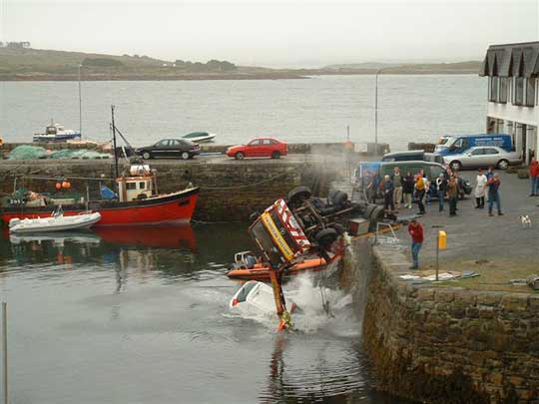
Sample characterization
Sample container (how am I going to acquire the sample)

Slide 9

Sample characterization
Can I reach the sample

Slide 10

Sample characterization
Tool selection

Slide 11
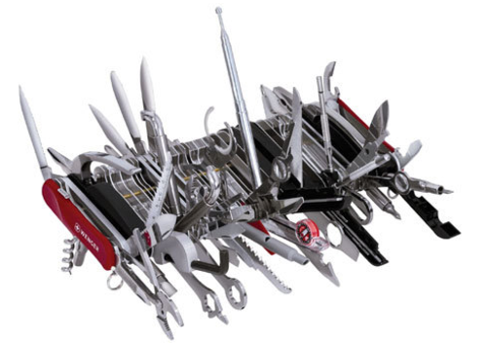
Sample characterization
Pre-prepared sampling kit

Slide 12
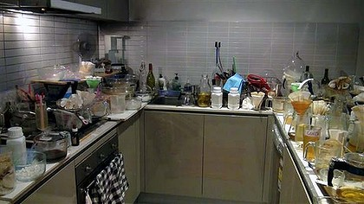
Sample characterization
Where am I going to put my sampling equipment

Slide 13

Radiation
Why do we check rad first
Can’t taste, feel, smell, hear it
Equipment is very sensitive
Always lead with rad

Slide 14
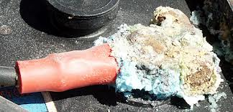
pH
Why do we check pH?

Slide 15
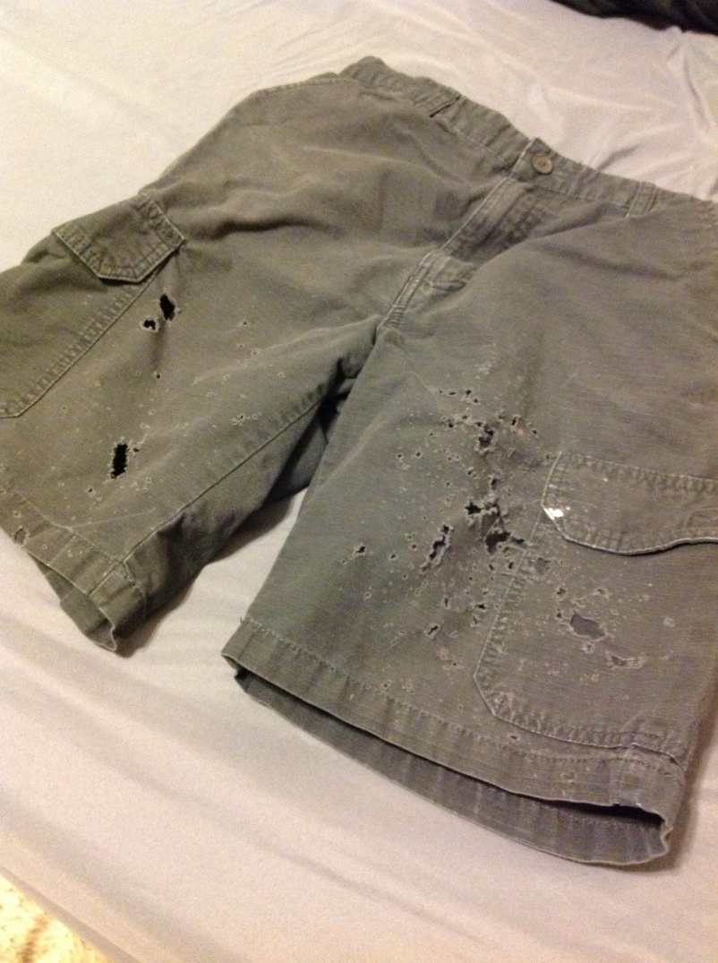
pH
Corrosiveness is the hazard
Critical for PPE selection

Slide 16
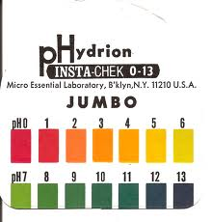
pH
Don’t care about number just red or blue
Be familiar how your pH paper works
Protect it from the environment during storage

Slide 17
5 gas
LEL correction factors (10%)
Sensor poisons
Cross sensitivity
Ionization potential
Sensor saturation

Slide 18


M8
Aqueous versus organic
Color changes are not definitive

Slide 19

Starch iodide (oxidizer)
Doesn’t work against nitrates, chlorate, perchlorates
Works well with peroxides and bleach

Slide 20
Chemical, biological or radiation?
Based on environment and sample characterization we divide into possible chemical, biological, or radiation
  Radiation leave in place

Slide 21
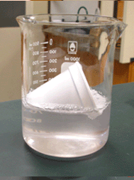
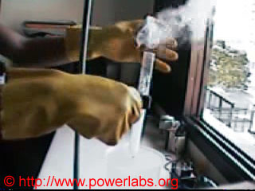
Chemicals
  We generally use glass sample containers

Slide 22

Biologicals
  Generally use plastic

Slide 23

Time for a demonstration

